Slide 1
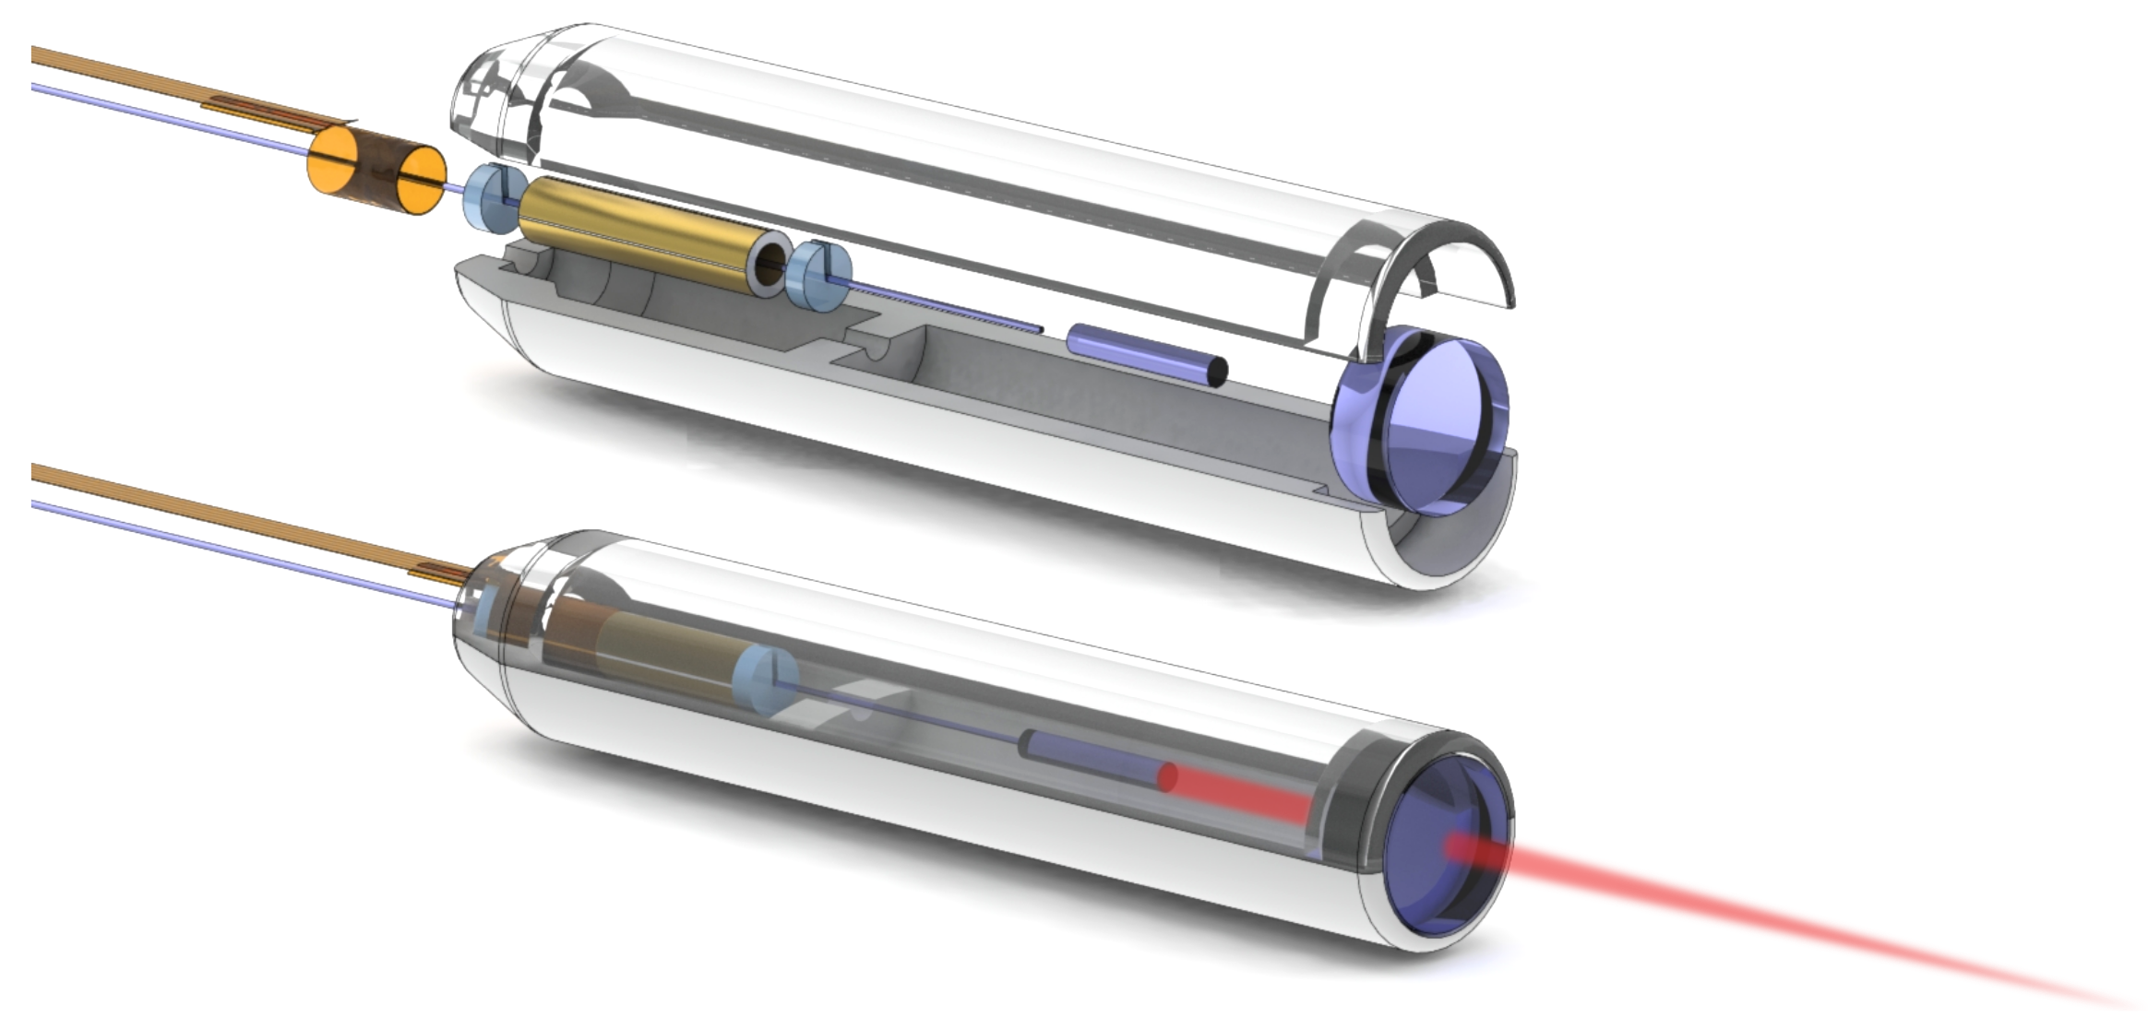
Compact OCT scanner for a bimodal endoscopic probe
Sergio Vilches
Notes:
[Keep whole laser beam]

Slide 2
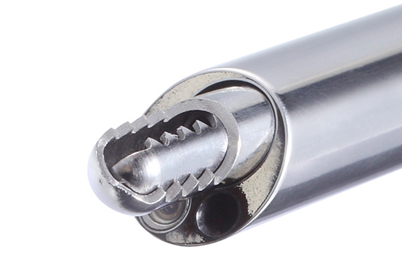
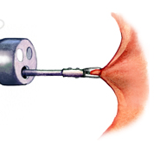
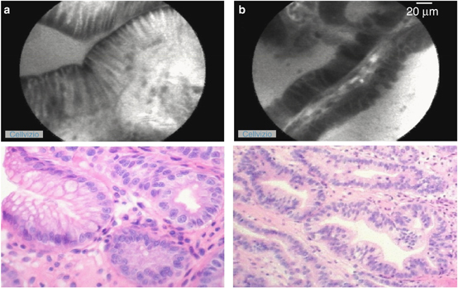
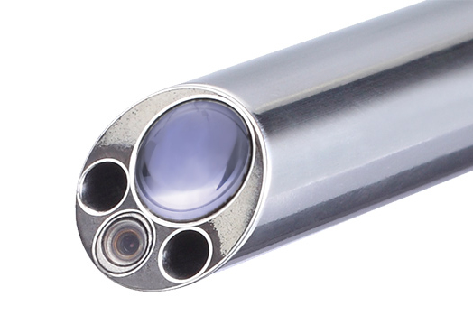
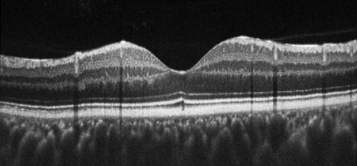
Motivation Optical biopsy
Conventional endoscopic biopsy (ex situ, ex vivo)
Biopsy
Histology
Diagnostic
Arteriovenous Malformation Fujii T. Kuwano H.
Transversal OCT image of the macula J. A. Flatter and J. Carroll,
http://colorectalsurgeonssydney.com.au/?page_id=425
joimax GmbH
Optical biopsy (in situ, in vivo)
Microscopy
OCT
Diagnostic
Notes:
Analyze tissue inside body: Endoscope. Camera
Conventional biopsy
Forceps: extract tissue
Histology:
Alternative developed in recent years:
Using advanced optical techniques to diagnose
Microscopy + OCT
Here IMTEK designing such probe

Slide 3
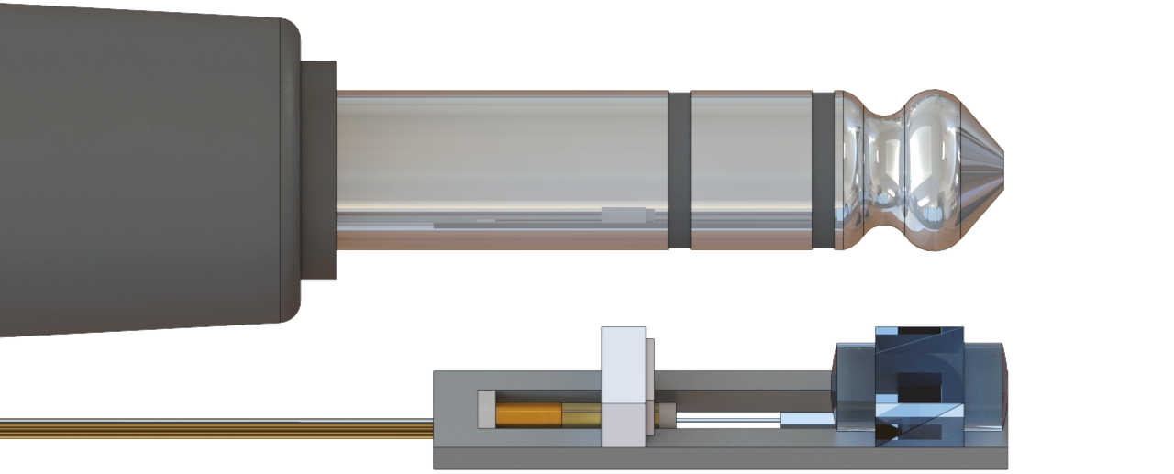

Fiber scanner Bimodal implementation: Size
$$\text{13 }\text{×}\text{ 2 }\text{×}\text{ 3 }{\text{mm}}^{\text{3}}$$
Notes:
Get an intuition of the size

Slide 4
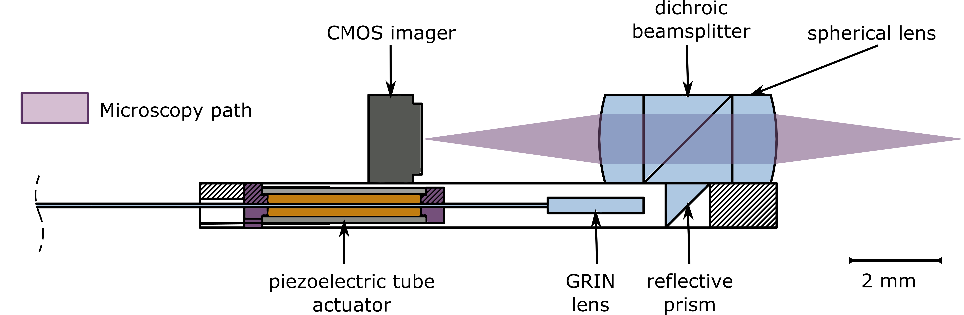
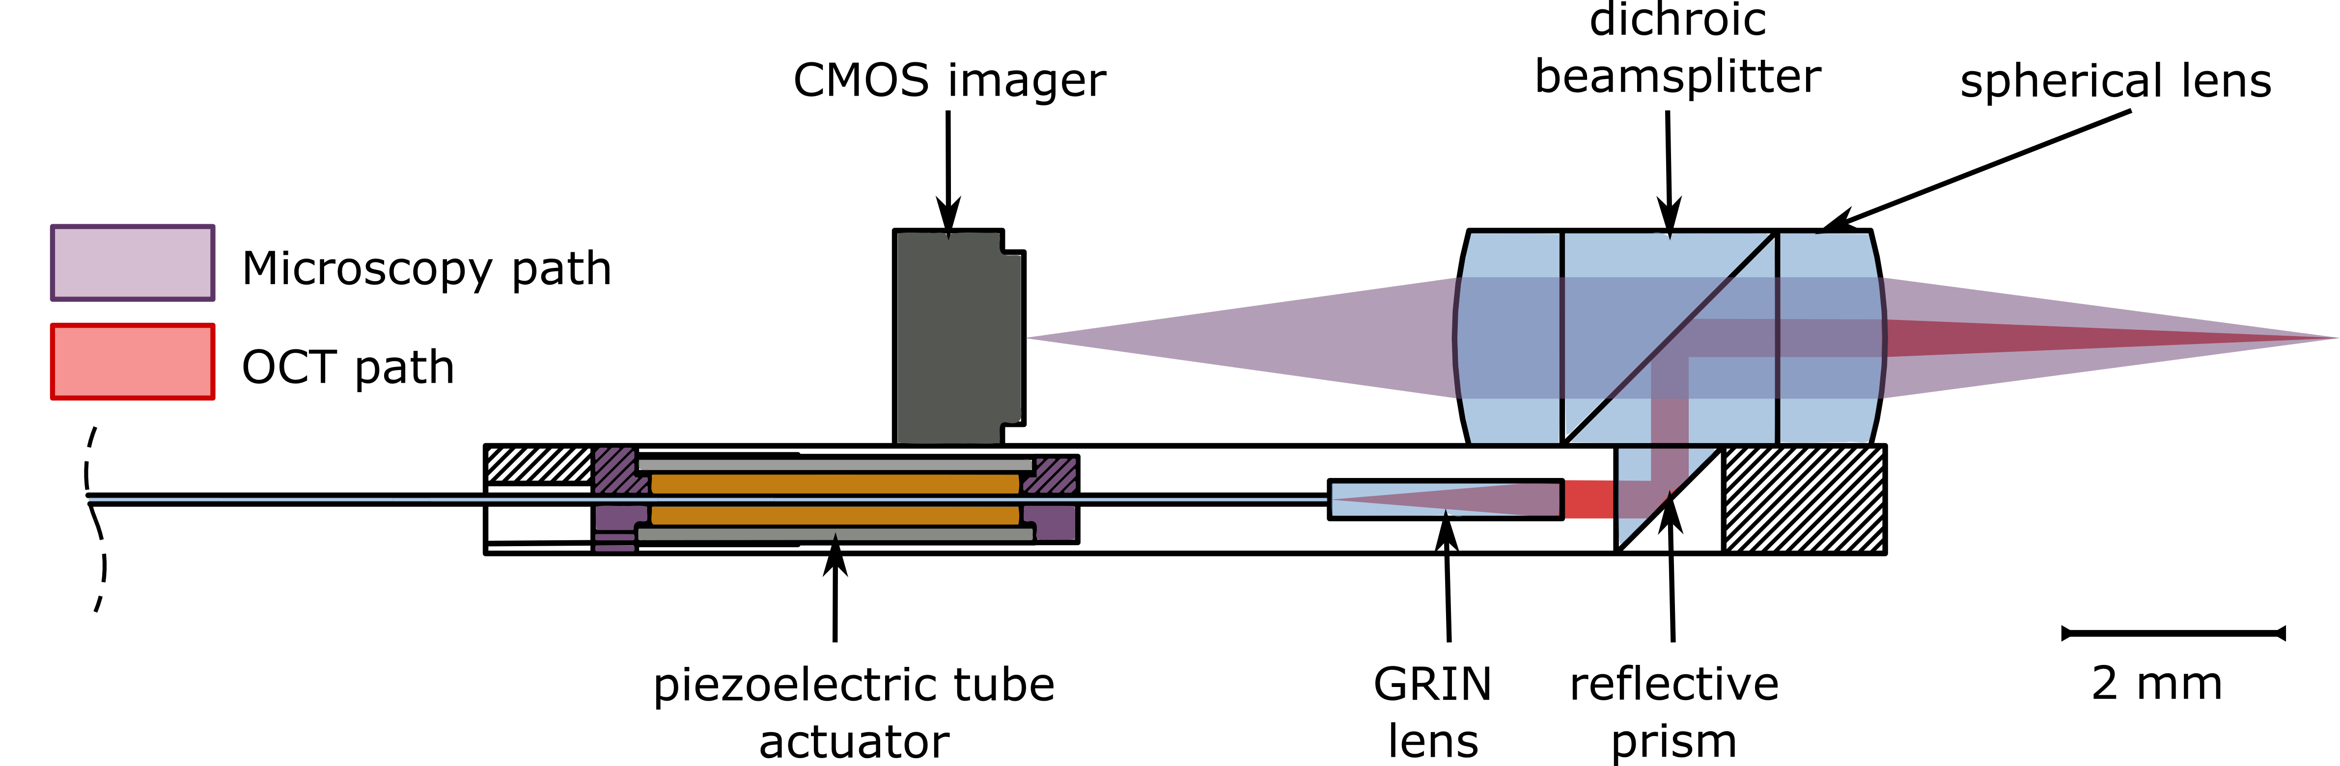
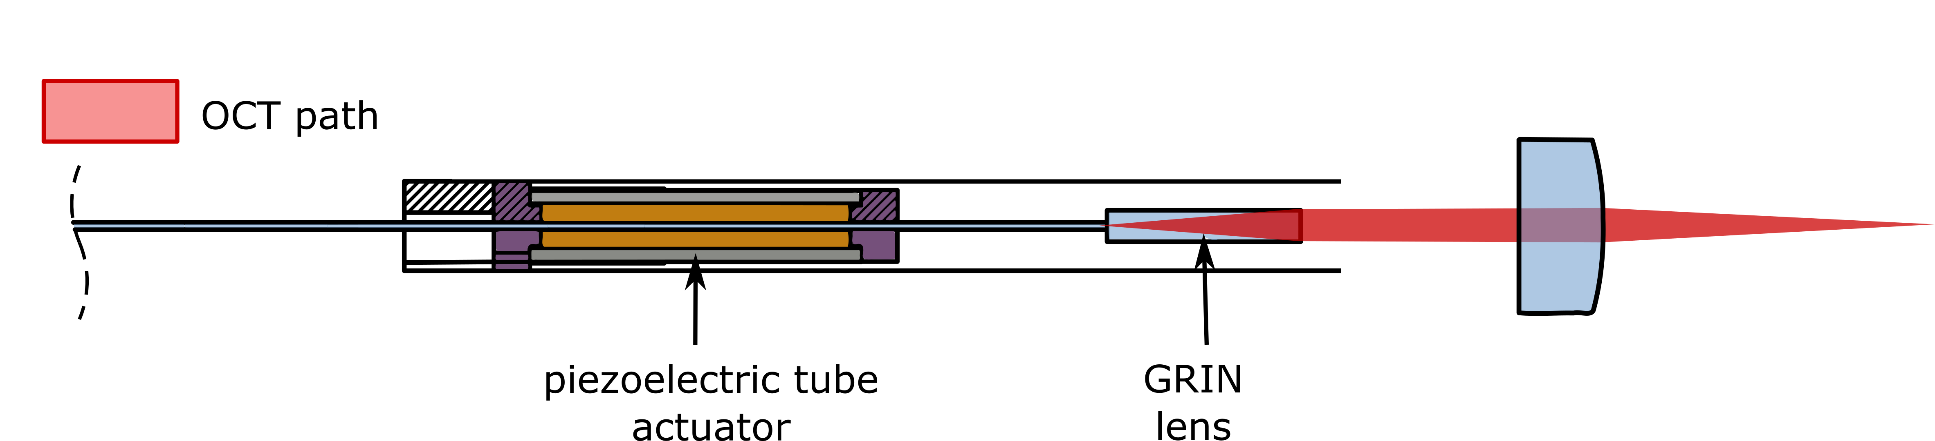
Fiber scanner Bimodal implementation
Notes:
Proposed implementation of bimodal probe
2 layer design
Independent beampaths, combined by dichroic beamsplitter
Ensure registration of both fields
Unfold the path
This thesis focuses on the OCT beampath design
-> Brief introduction to OCT

Slide 5
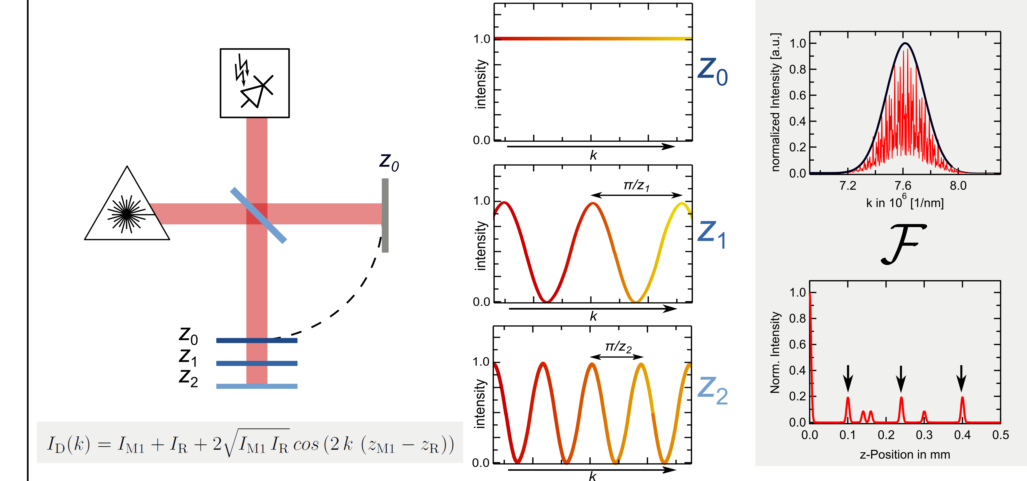
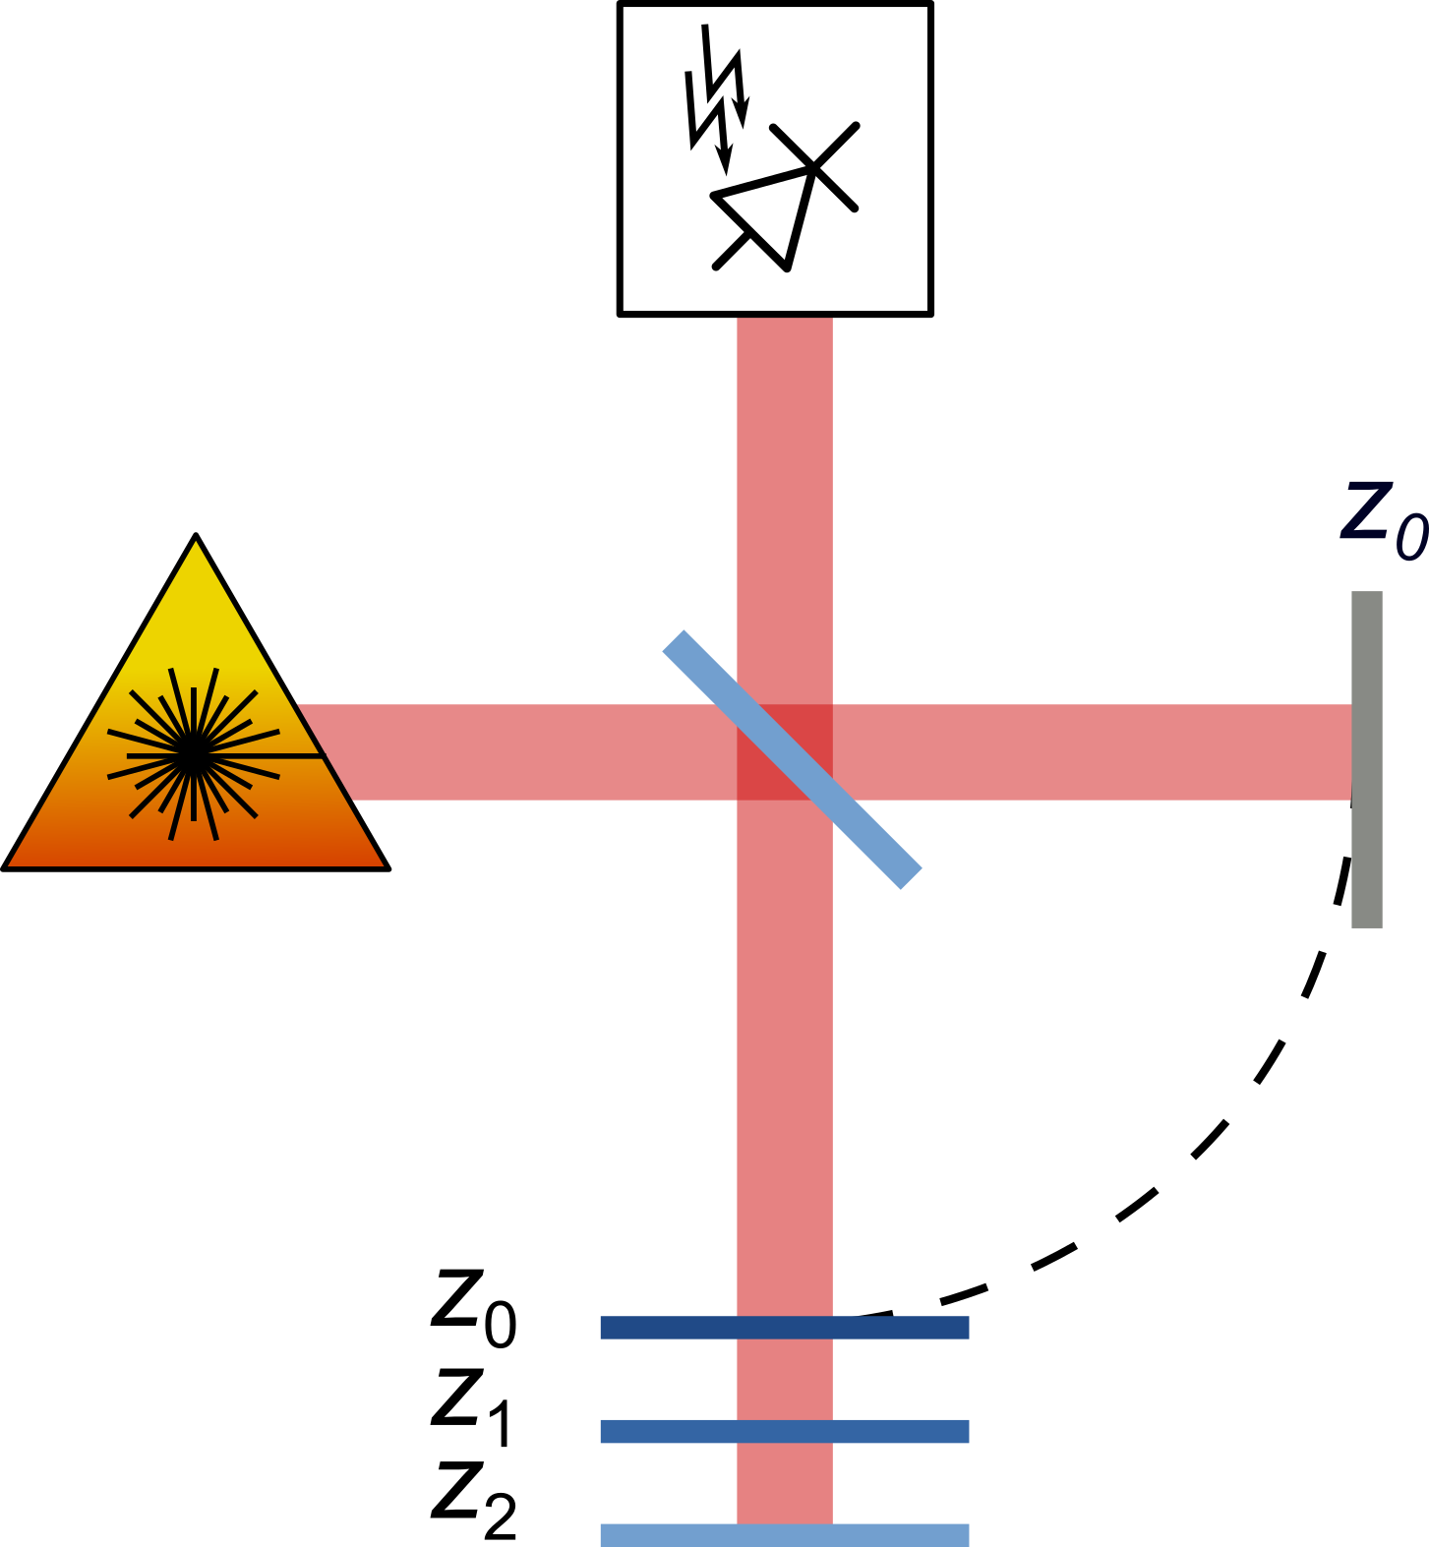
Swept-Source Optical Coherence Tomography SS-OCT Theory
Single sample reflector
Multiple reflectors
reference
mirror
sample
Notes:
SS-OCT = Technique to measure depth information of a sample by analyzing its backscattered light.
Michelson interferometer with a laser which can sweep its wavelength.
Intuitive explanation: Imagine reflector in sample arm
If placed at same distance as reference arm: constructive interference at all wavelengths
If placed at z1, some wavelengths constructive, other destructive
Spectrogram modulated by distance
Cross correlations / Autocorrelations
[Distribute]

Slide 6
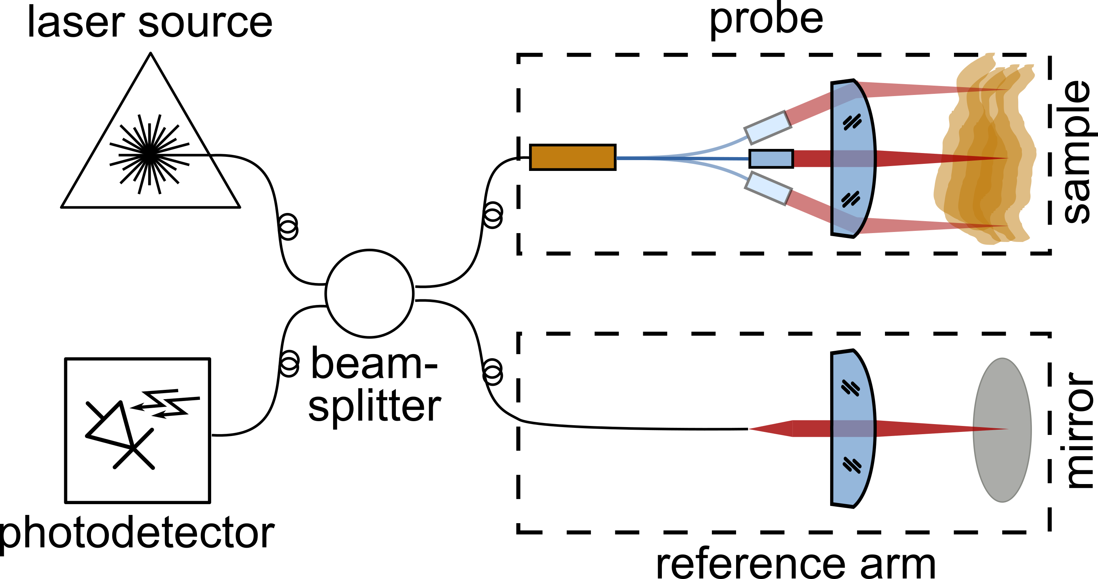
Swept-Source OCT: Fiber scanner requirements
Optical requirements:
Long depth of field: > 2 mm
Scanning mechanism
High field of view for 2 mm lens
Telecentric
Mechanical requirements:
Diameter < 3.3 mm
Scanning mechanism adequate for OCT sampling rate (100 kHz)
Notes:
OCT systems endoscopy: fiber based
Same components but now probe goes into body
Practical requirements: Low NA 0.02

Slide 7
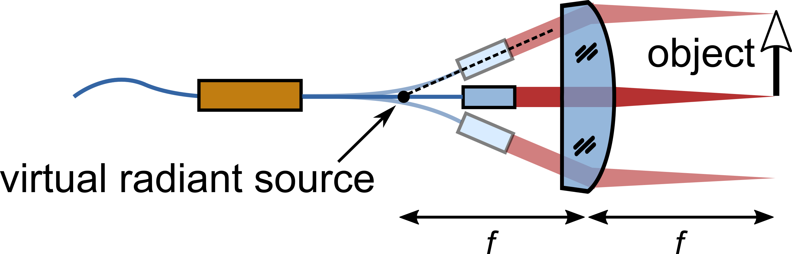
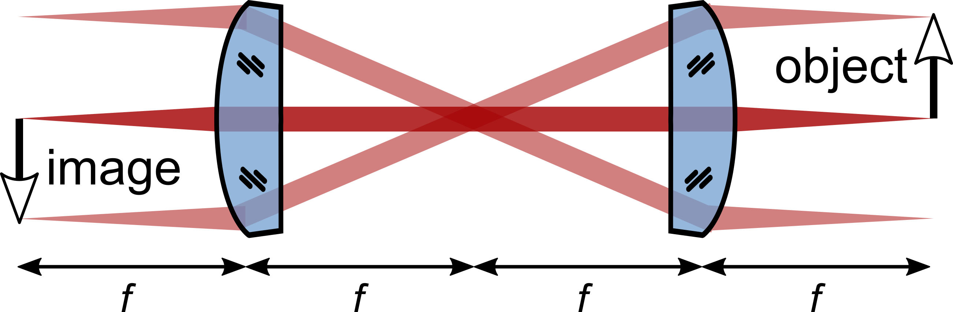
Fiber scanner Fourier plane scanner
Fourier plane
Notes:
Conventional microscopy: translation – angle - translation
Fourier plane scanner
-> How to achieve this angle scanning?

Slide 8
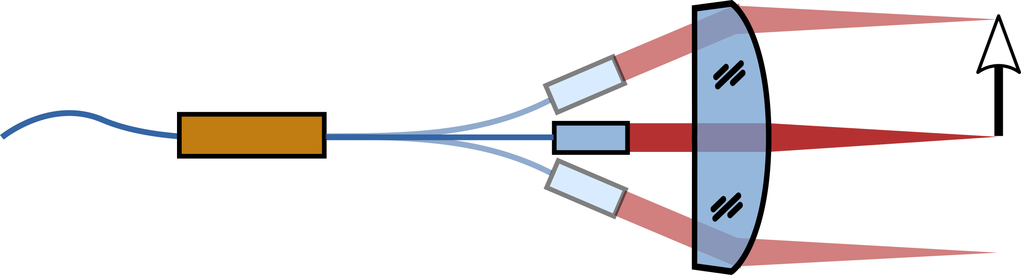
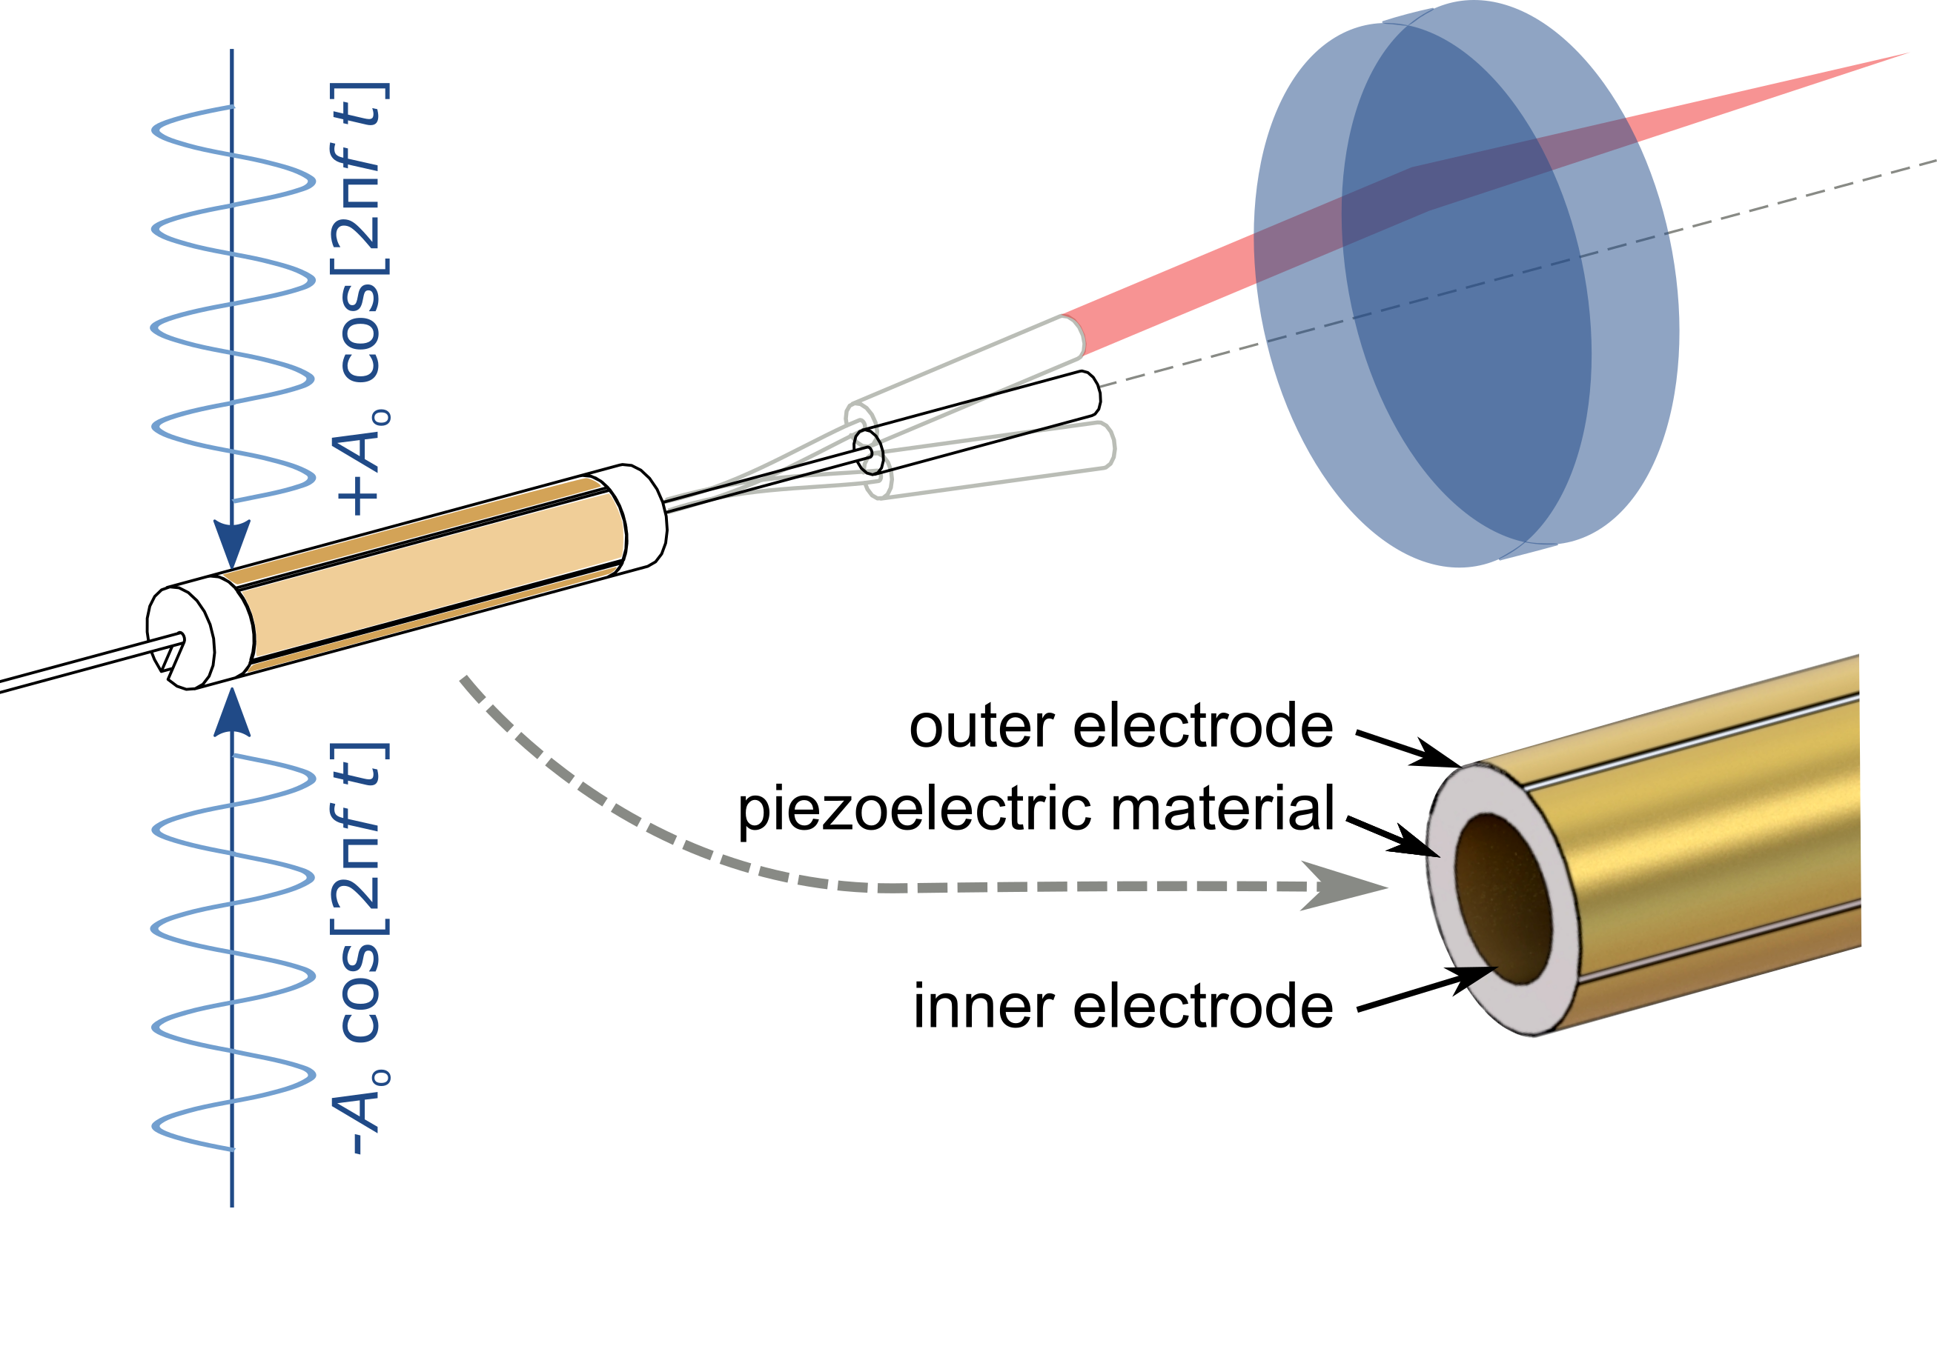
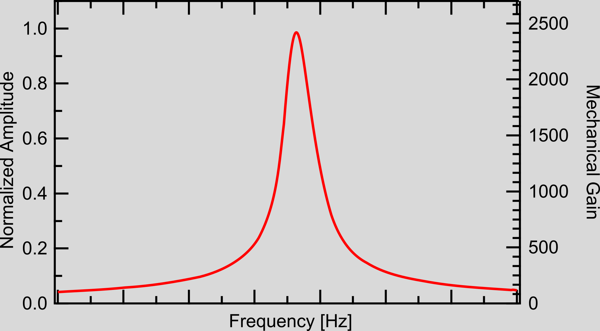
Fiber scanner Piezoelectric actuation + Mechanical amplification
Notes:
Piezoelectric actuation + Mechanical amplification
Piezoelectric tube: 4 electrodes, fixed at base
Excites a cantilever formed by fiber+GRIN
Sinusoidal excitation at fres -> 1000x mechanical gain
Resonance: mechanics define fres
-> Lower fres as much as possible: analytical calculation

Slide 9
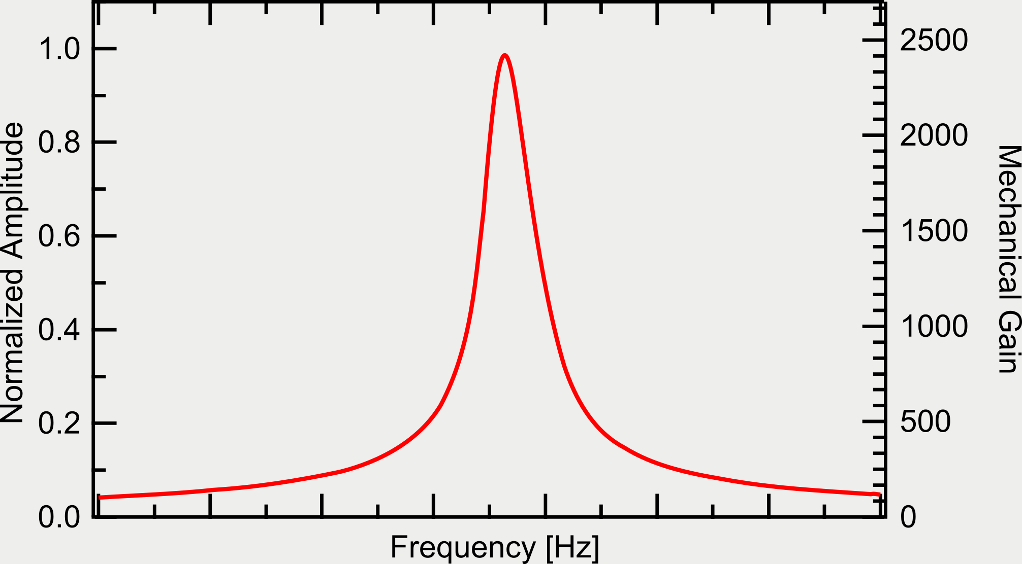
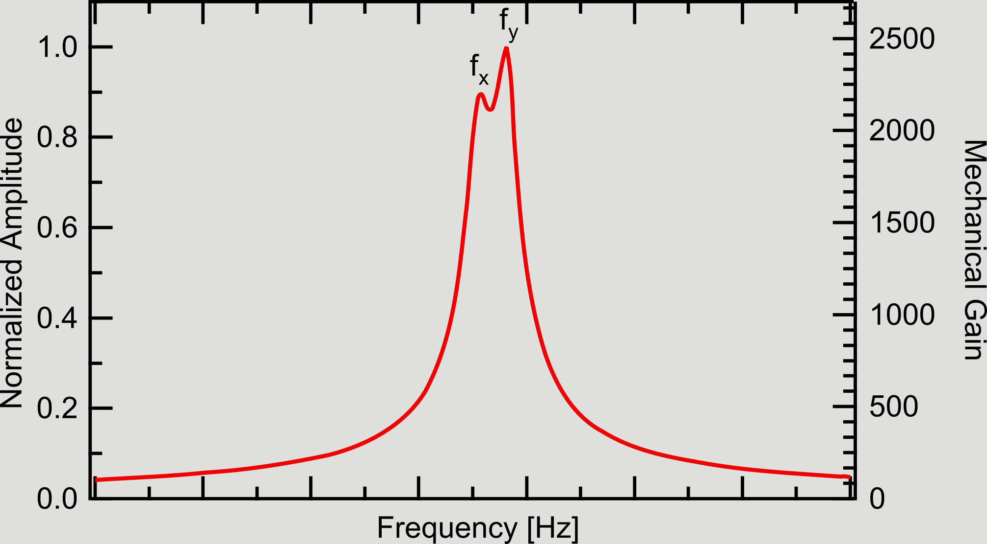
Fiber scanner Piezoelectric actuation + Mechanical amplification
Notes:
Piezoelectric actuation + Mechanical amplification
Piezoelectric tube: 4 electrodes, fixed at base
Excites a cantilever formed by fiber+GRIN
Sinusoidal excitation at fres -> 1000x mechanical gain
Resonance: mechanics define fres
-> Lower fres as much as possible: analytical calculation

Slide 10
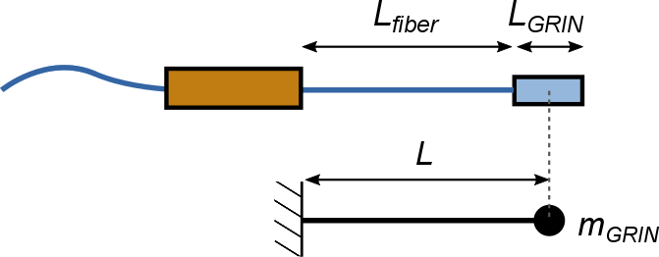
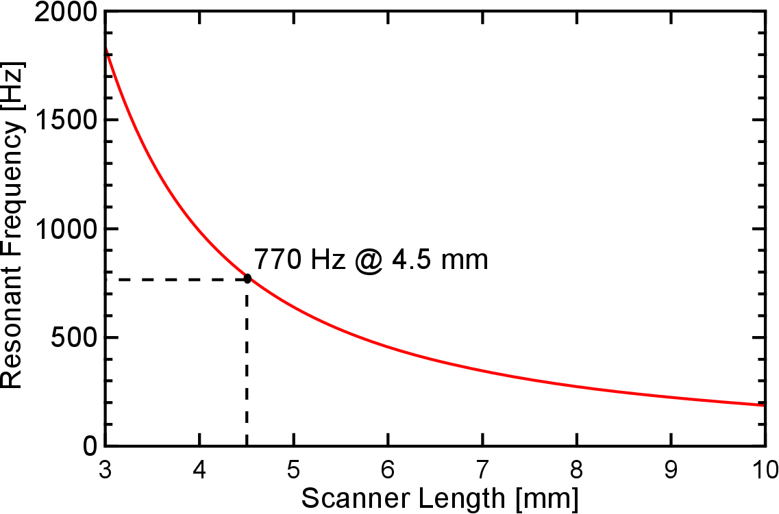
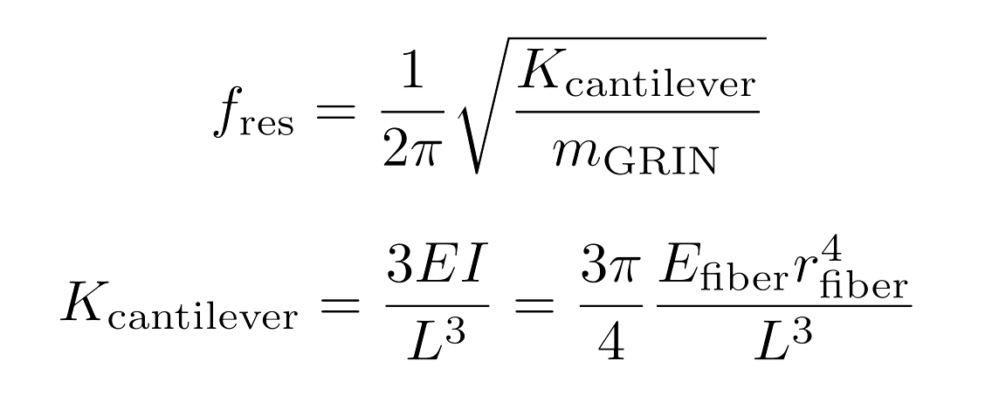
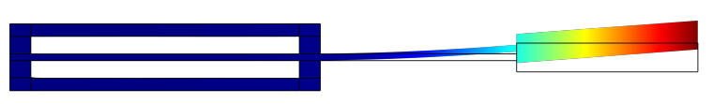
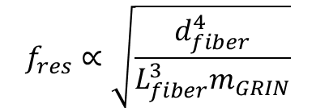
Fiber scanner Resonance frequency estimation
Analytical Calculation
770 Hz
COMSOL Simulation:
762 Hz
$$f_{res}∝\sqrt{\frac{d_{fiber}^{4}}{L_{fiber}^{3}m_{GRIN}}}$$
Notes:
Estimation by modelling the GRIN as point weight
Dependance: Dfiber, length, mass
Reduced d fiber to 80 um
Placing GRIN at tip
-> Optical analysis of the scanner

Slide 11
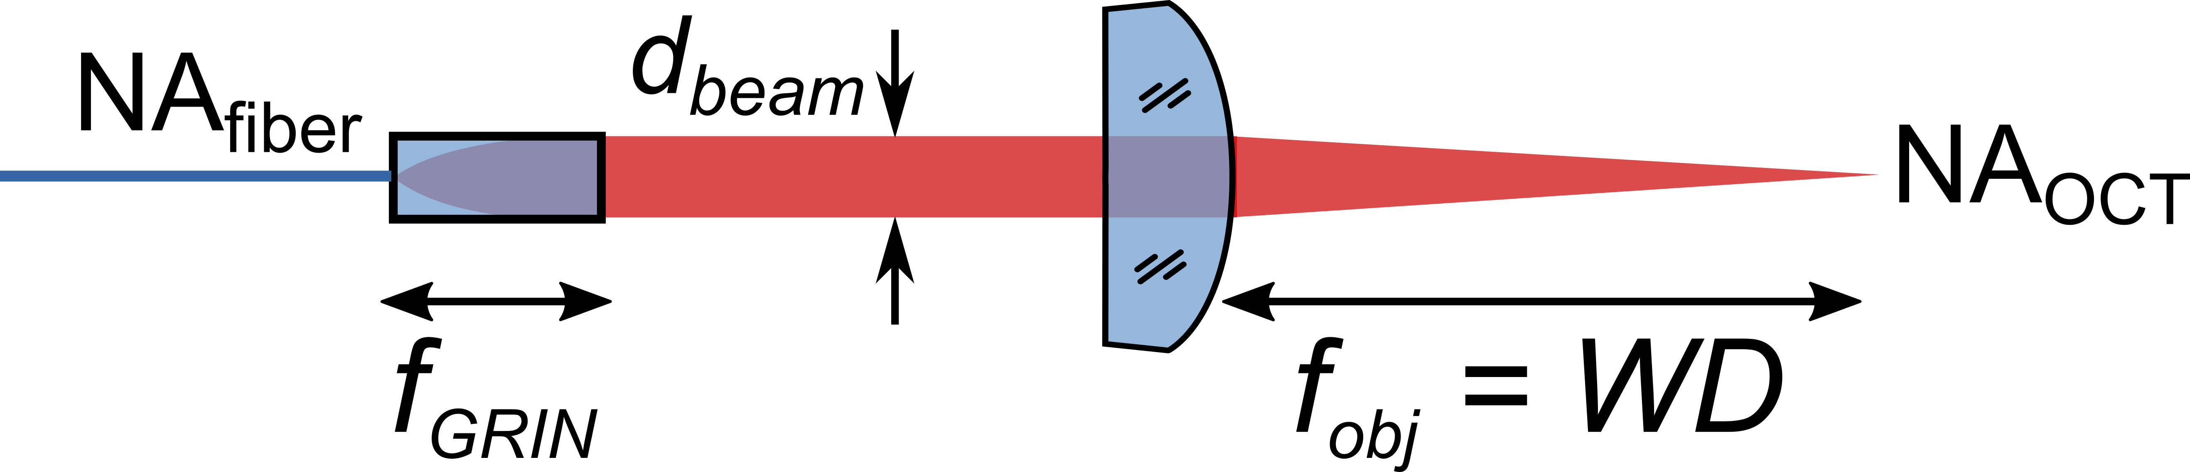
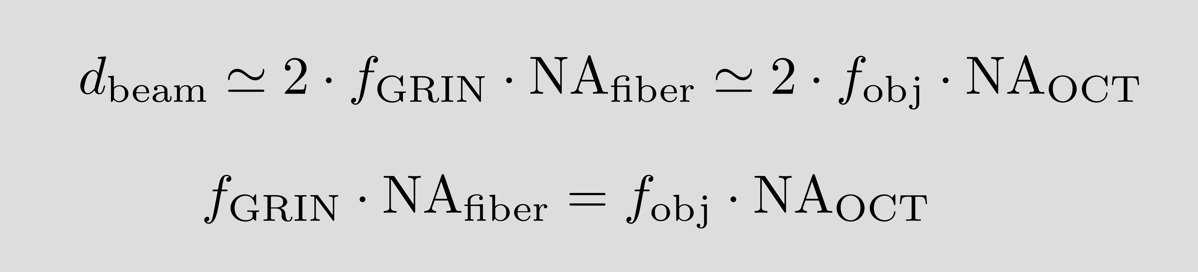
Optical performance Geometrical optics
Parameter | Value
NAfiber | 0.18
NAGRIN | 0.2
fGRIN | 0.91 mm
dbeam | 0.3 mm
fobj | 7.5 mm
NAOCT | 0.022
Notes:
Geometrical optics:
Interrelated parameters
Set NA
Calculate resolution of such system
OCT: Illuminate with laser, collect light

Slide 12
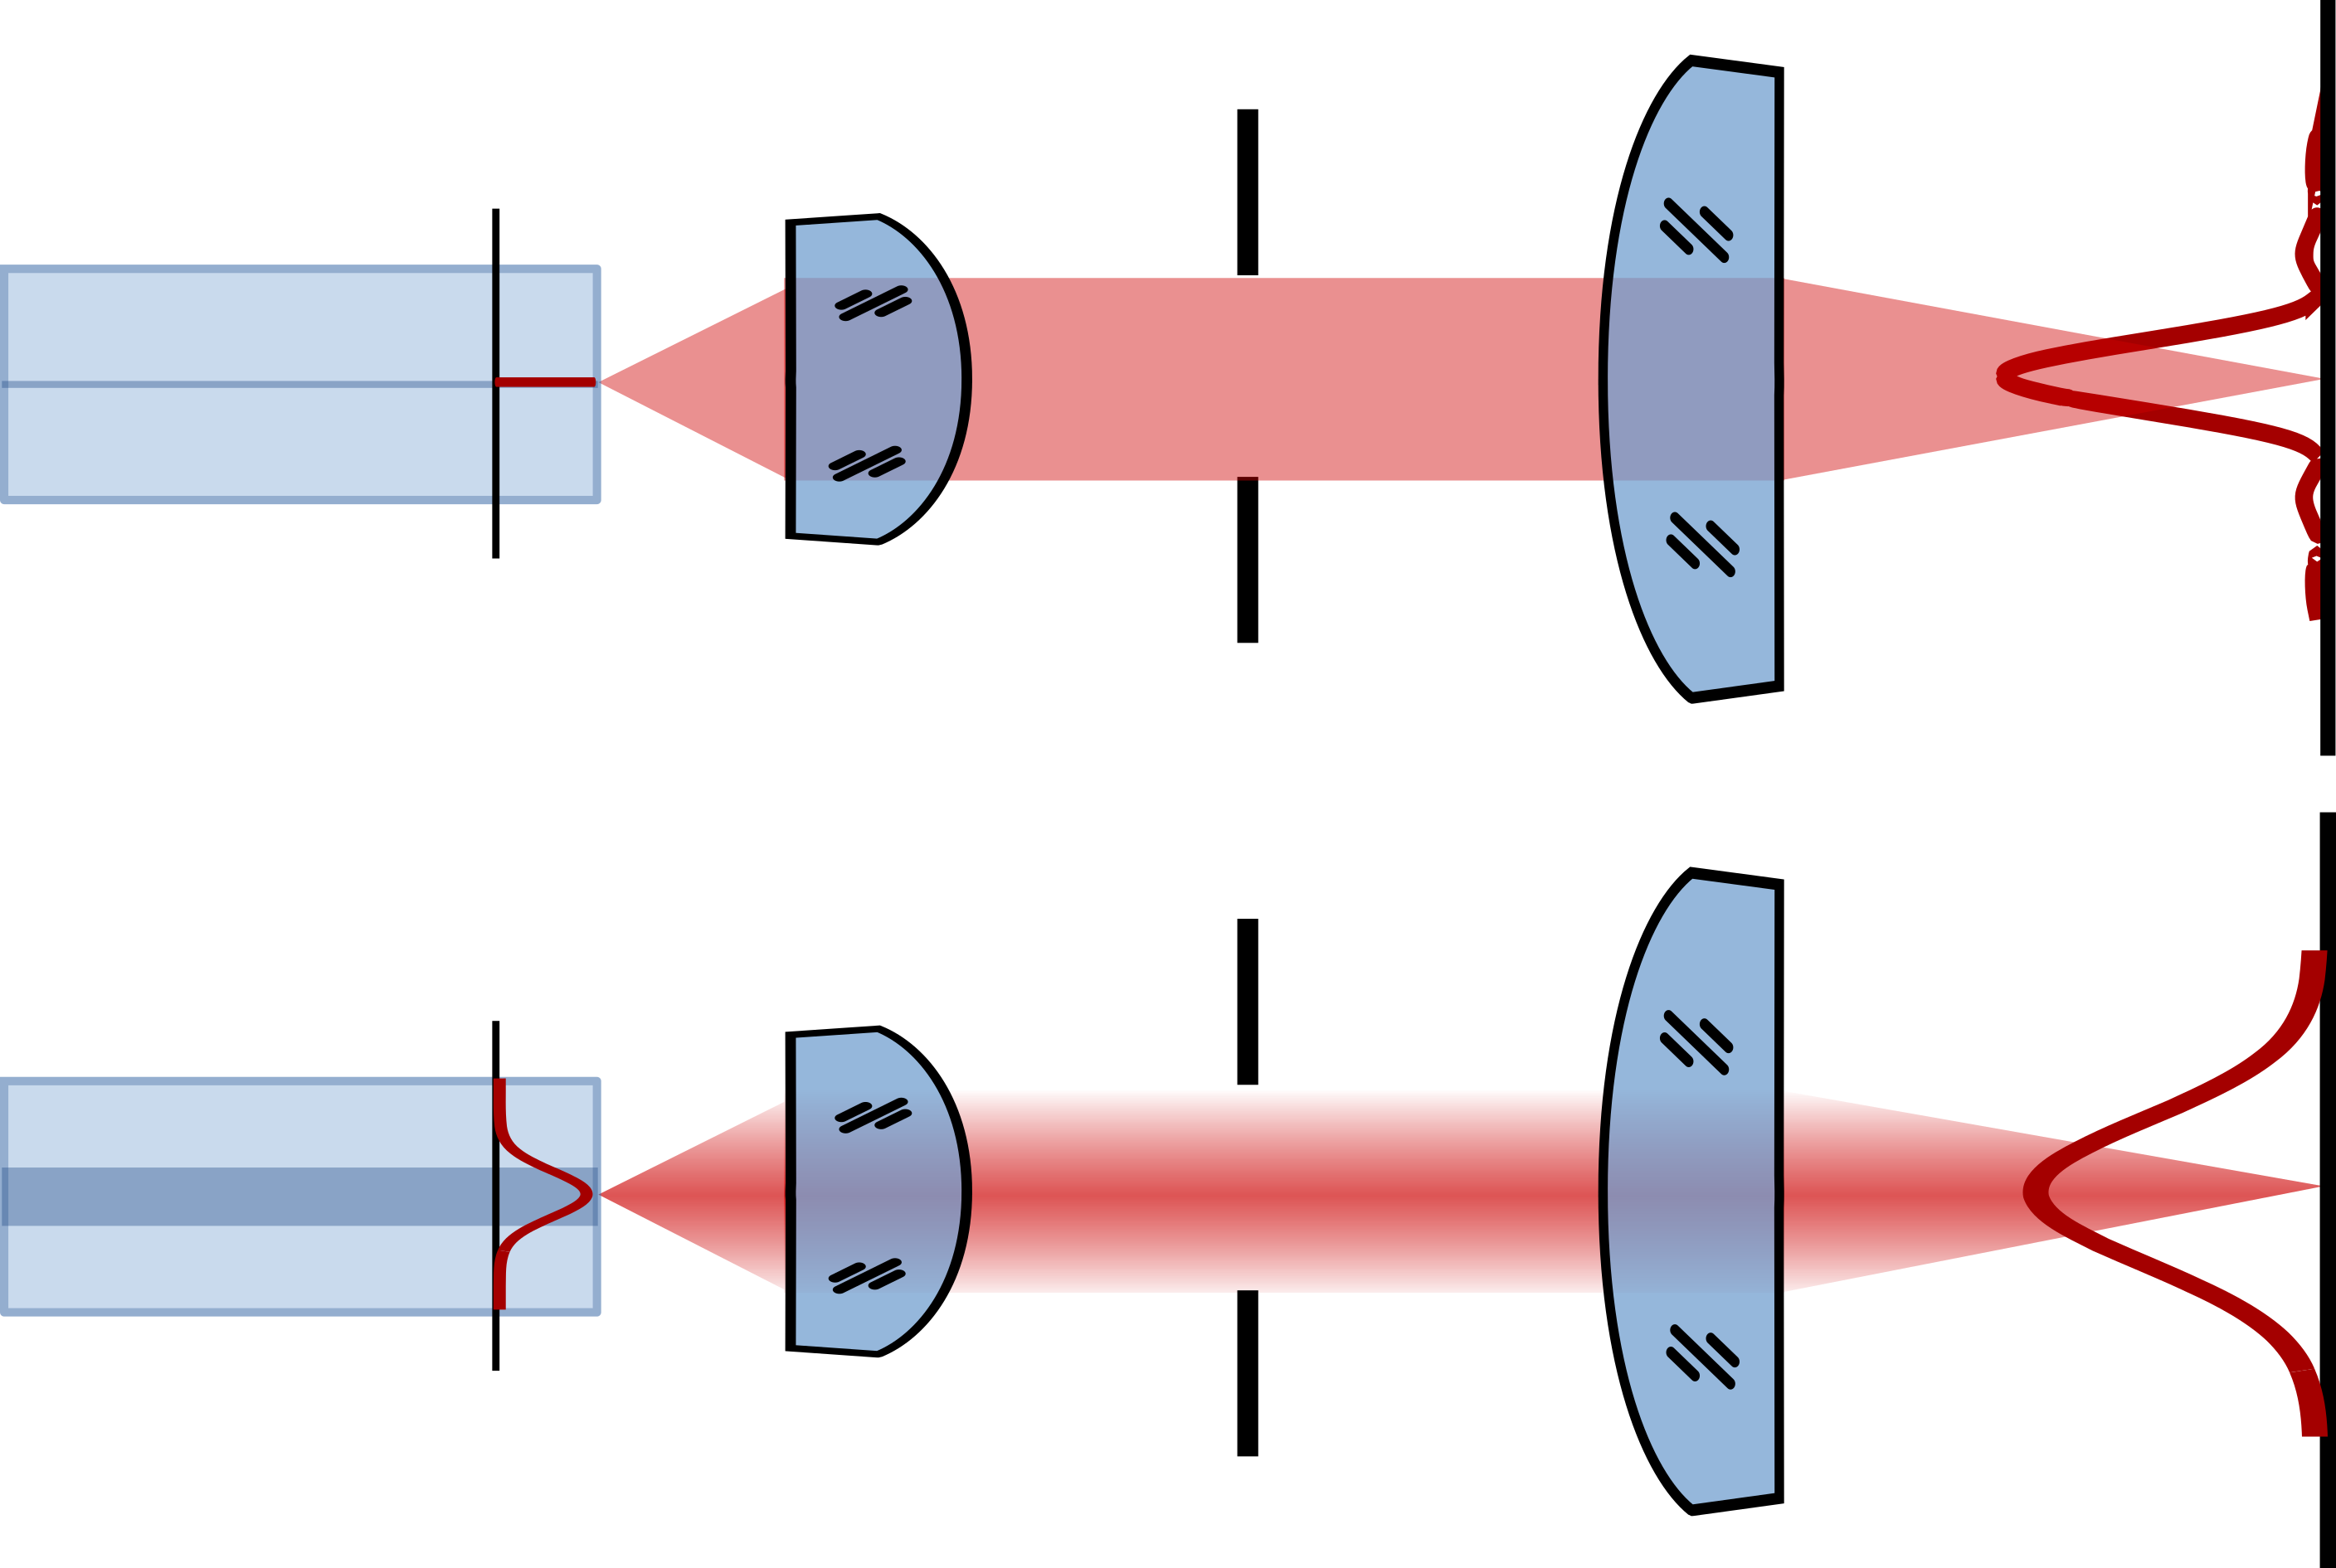
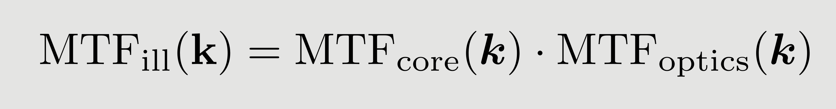
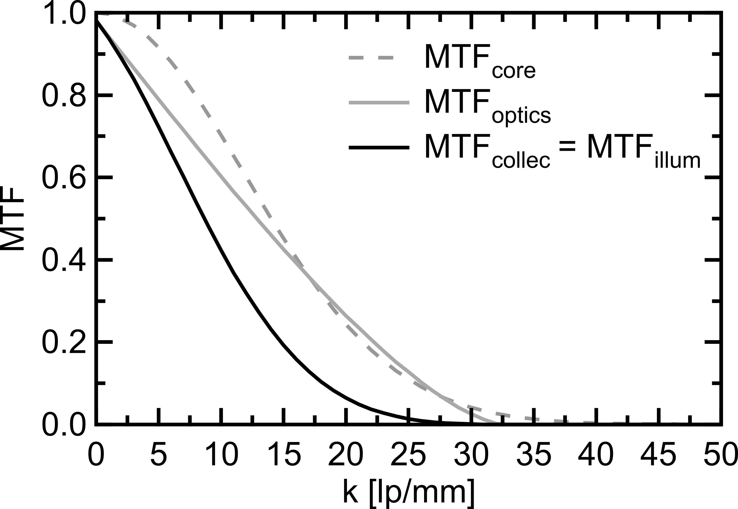
Optical performance Fourier optics: illumination PSF
objective
GRIN
PSFoptics(x)
Infinitesimal
fiber core
objective
GRIN
PSFoptics(x) * MFD(x)
Gaussian mode fiber core
Notes:
Start considering illumination: projector
Fiber - lens - aperture – sample
If fiber is point source – PSF shape defined by optics (NA), beam diameter
If fiber has an extended mode shape: convolution of both
-> What happens with backscattered light?

Slide 13
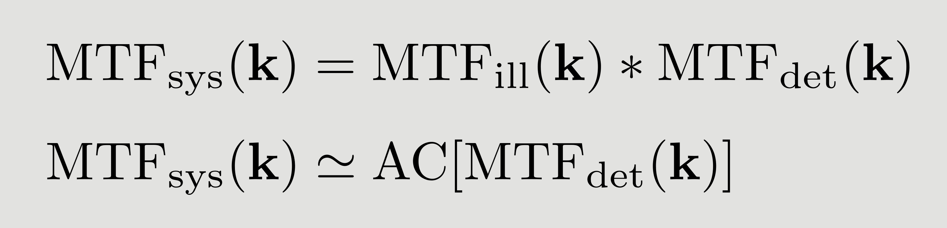
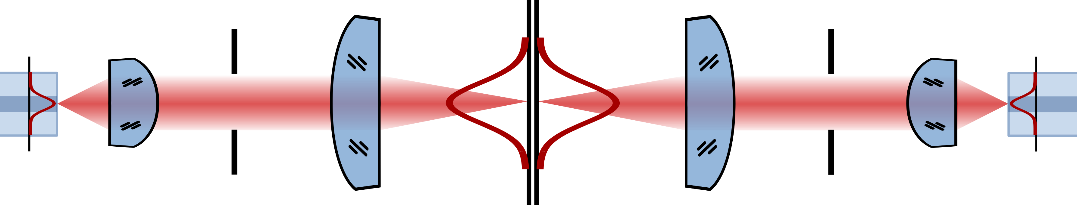
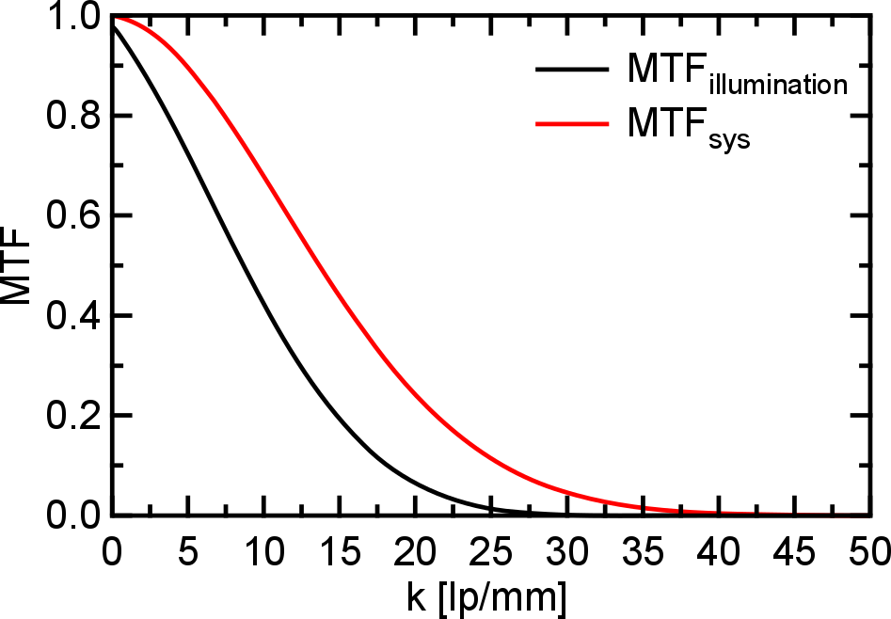
Optical performance Fourier optics: illumination + collection
illumination
detection
sample
probability
of
illumination
×
probability
of
detection
23.3 lp/mm
43 µm
CRayleigh
Notes:
Helmholz reciprocity: Folded optical system
In order that photon reaches the detector:
Illuminate inside PSFill
Be accepted into the optical system
Same PSF squaring
Squaring of PSF – Autocorrelation of MTF
-> What happens for beams at an angle? Aberrations?

Slide 14
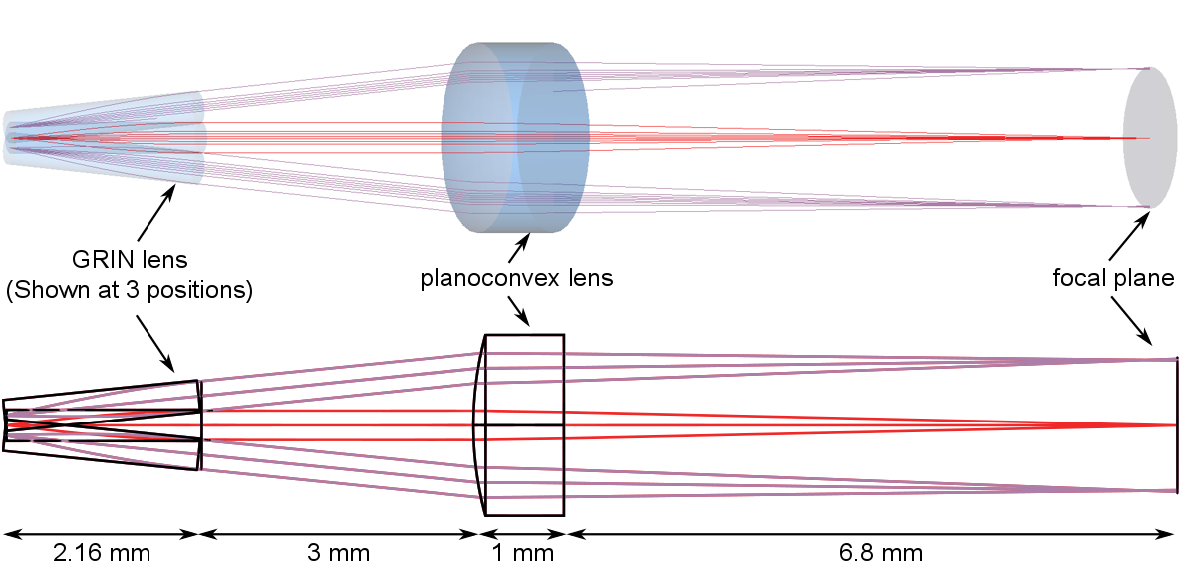
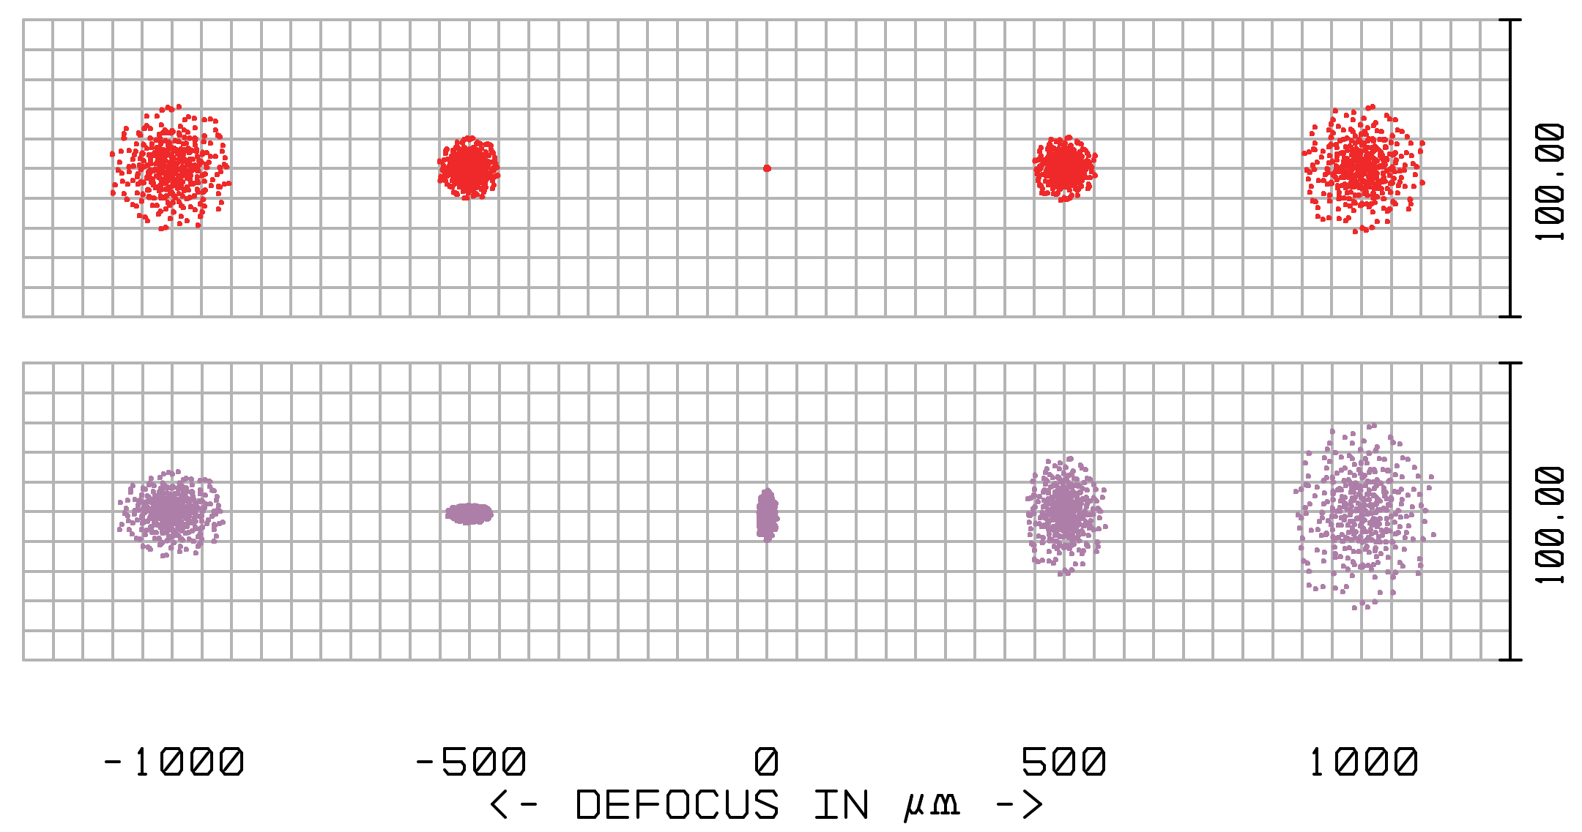
Optical performance ZEMAX simulation: Geometrical raytracing
raytracing
spot through focus
1.5 mm
= Airy disk (86 µm diameter)
Notes:
1.5 mm FOV
Central/marginal rays
Converge in focal plane?
Spherical lens: Spherical aberration: Marginal rays spread
-> Analyzed, simulated -> Test its behavior

Slide 15
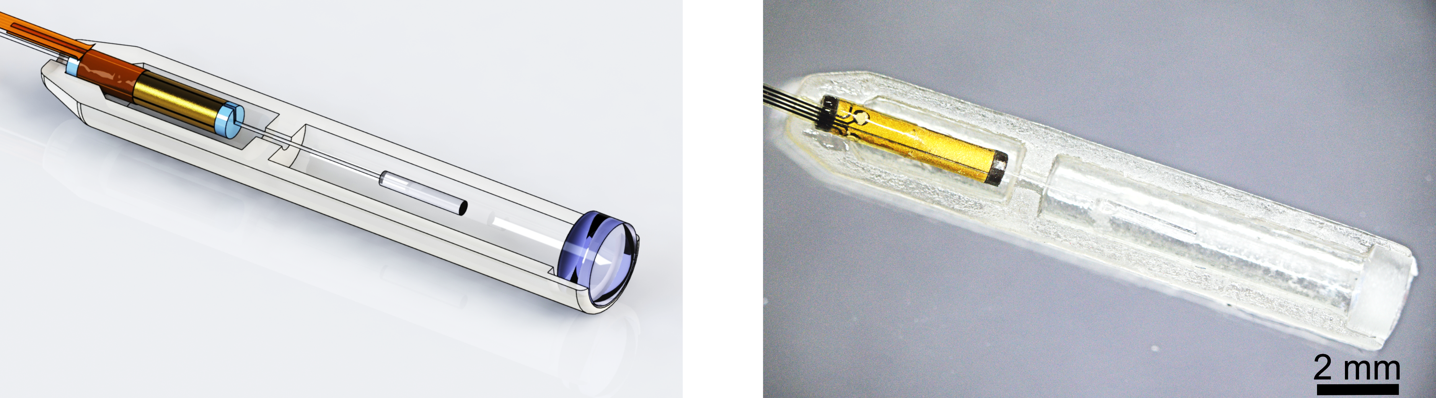
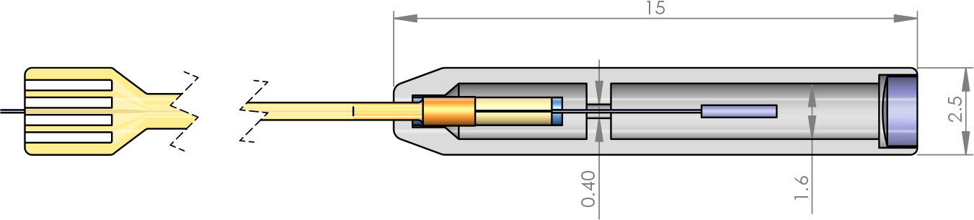
Implementation Single modality probe
Notes:
Implementation of single modality, OCT probe
Equivalent optics, mechanics
3D printed housing
Custom PI interconnects

Slide 16
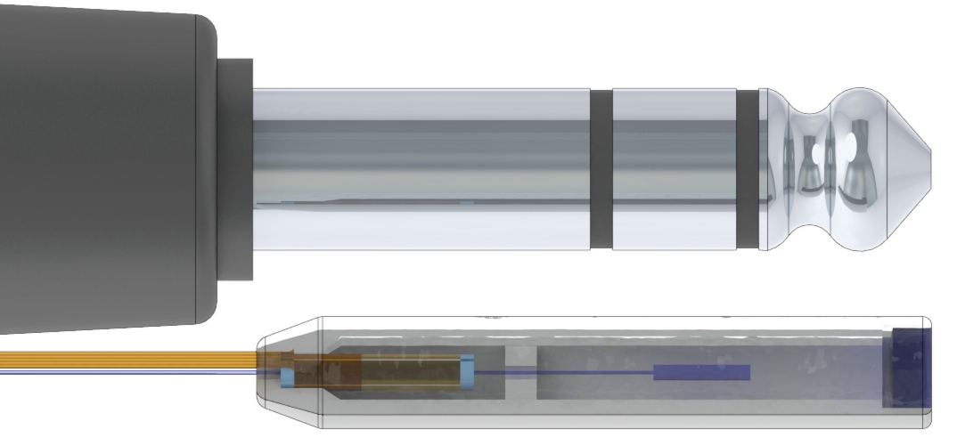

Implementation Single modality probe: size
3D Printing by:
Laboratory for Materials Processing (Bilal Khatri)
Laboratory for the Design of Microsystems
$$\text{15 }\text{×}\text{ 2.5 }\text{×}\text{ 2.5 }{\text{mm}}^{\text{3}}$$
Notes:
Implementation of single modality, OCT probe
Equivalent optics, mechanics
3D printed housing
Custom PI interconnects

Slide 17
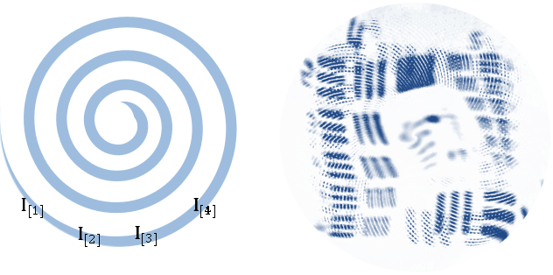
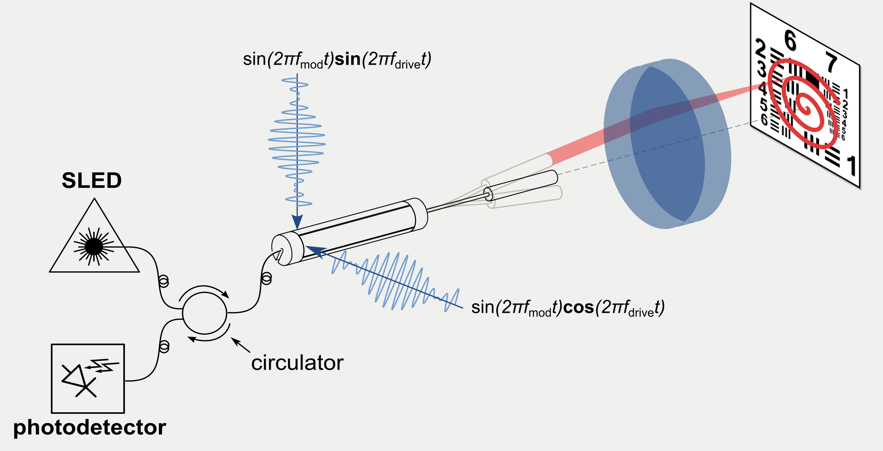
Experimental evaluation Laser scanned imaging
1.2 mm
Notes:
Experimental evaluation: Obtain Laser Scanned Images
Measure intensity of backreflected light
Setup
2D area: spiral scanning
FOV

Slide 18
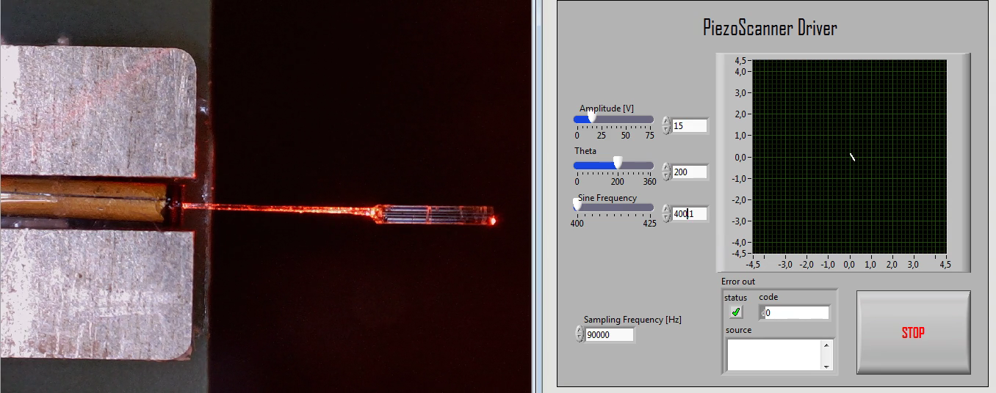
Experimental evaluation Whirling

Slide 19
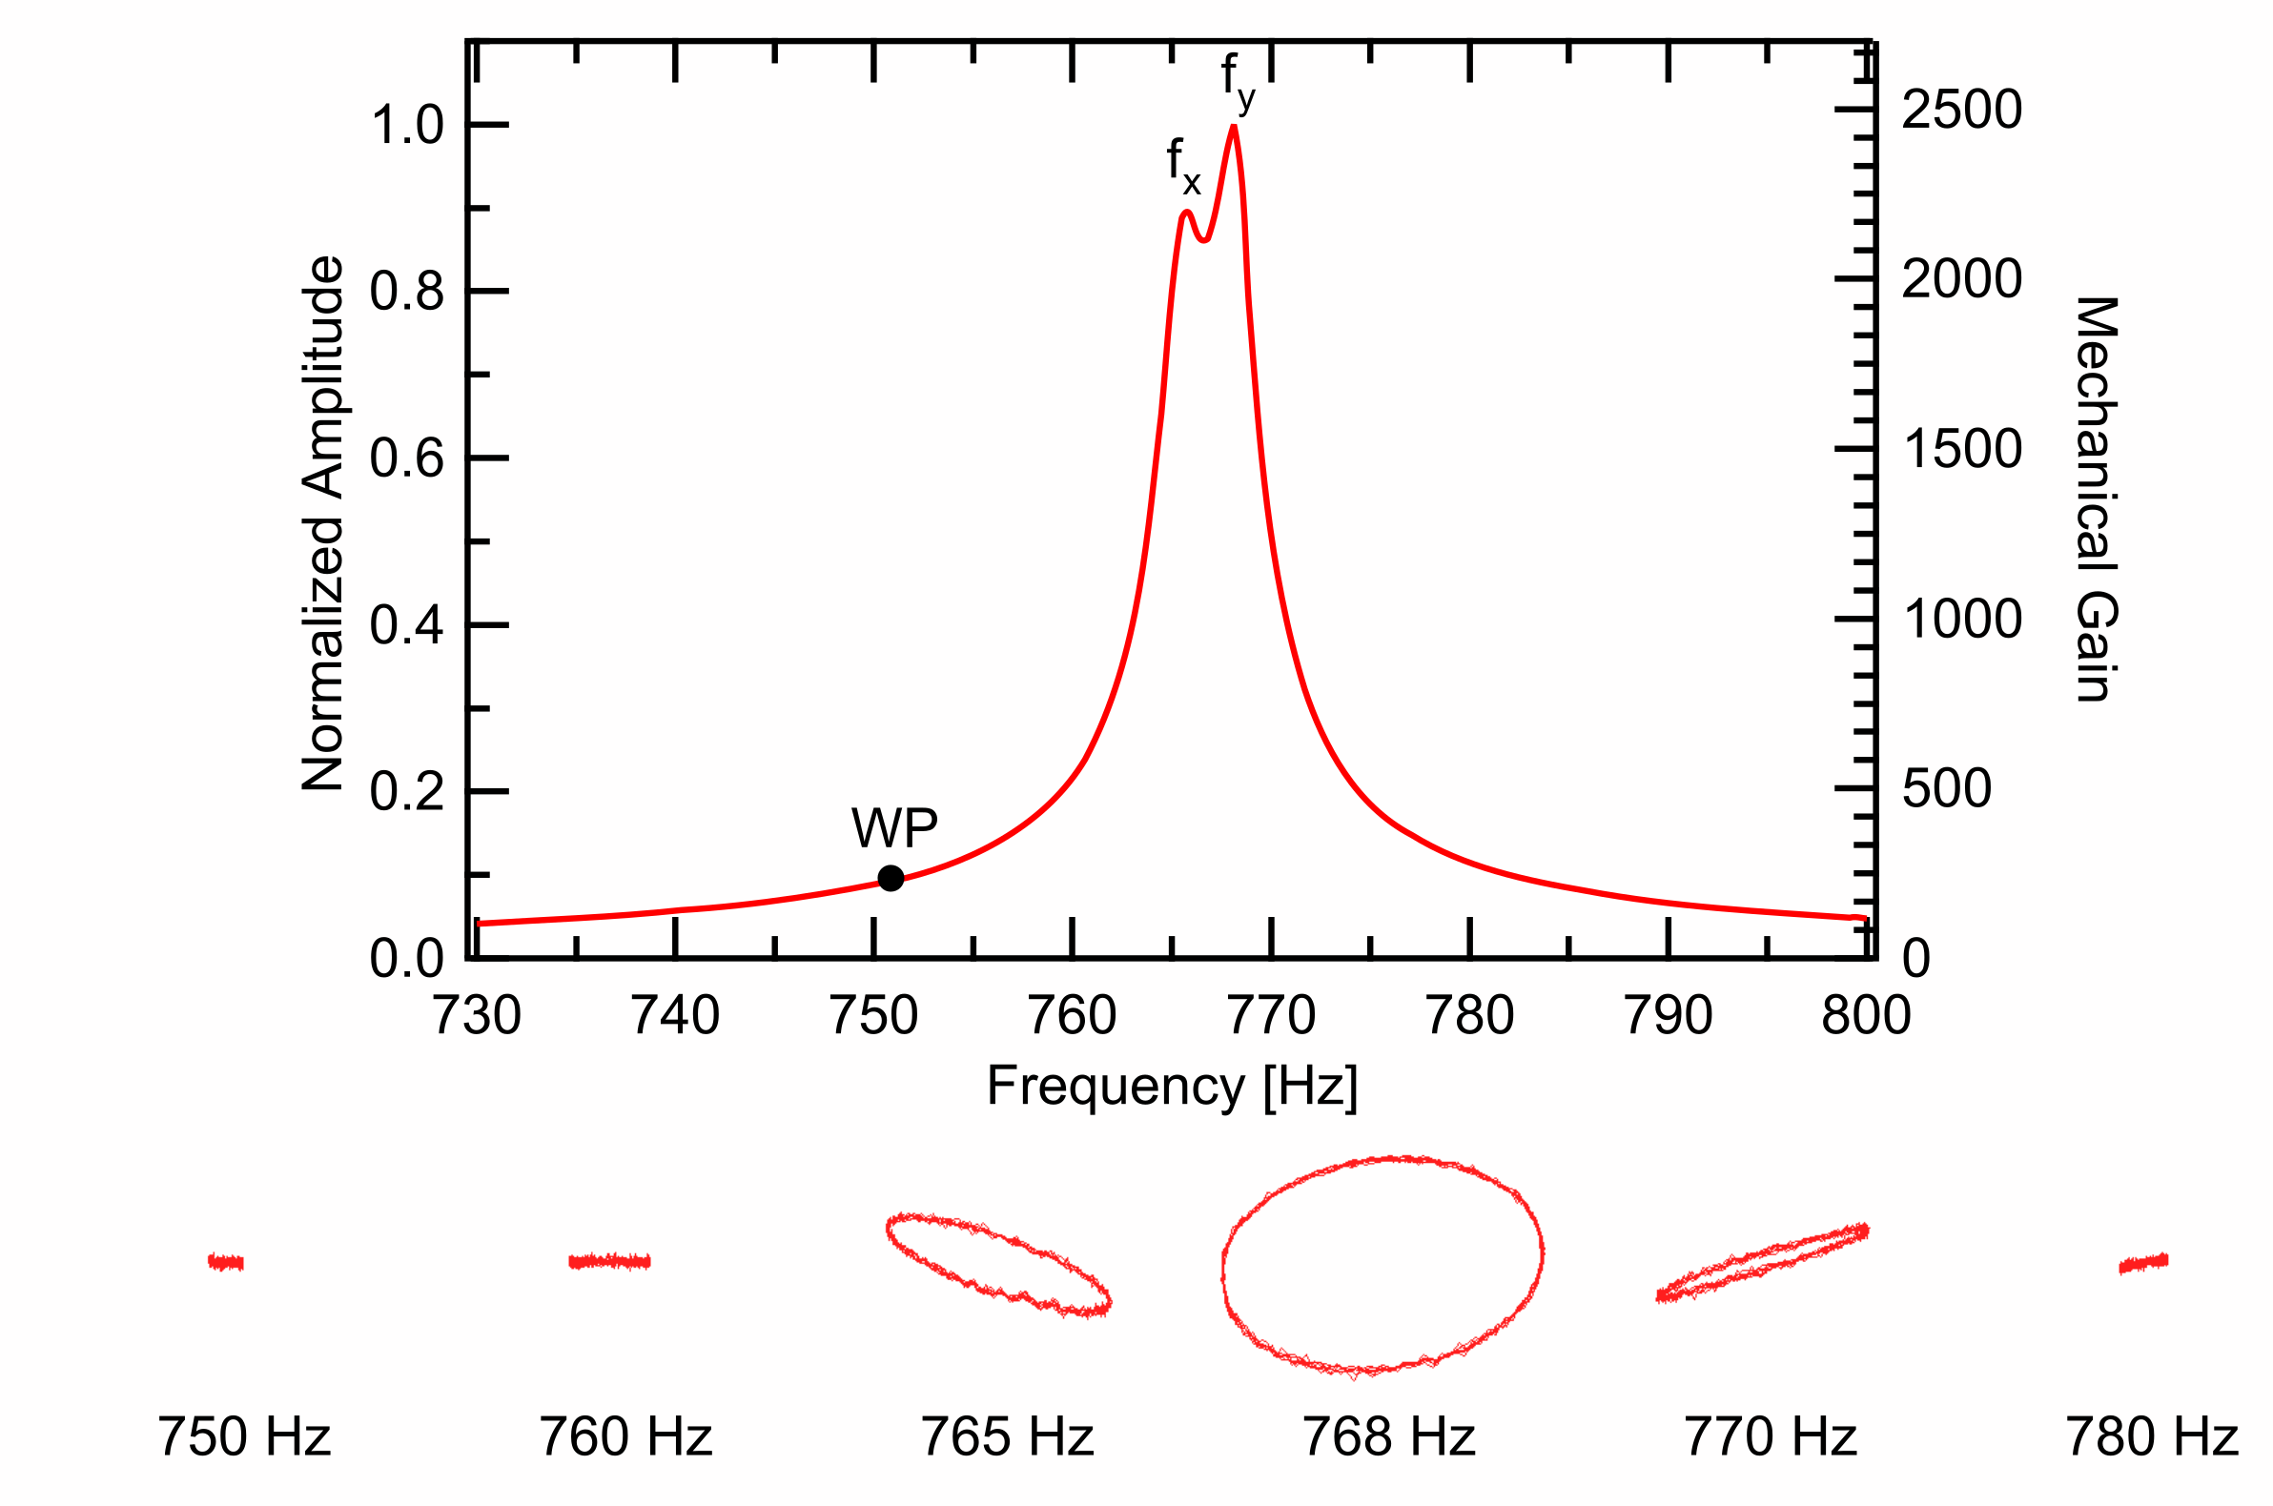
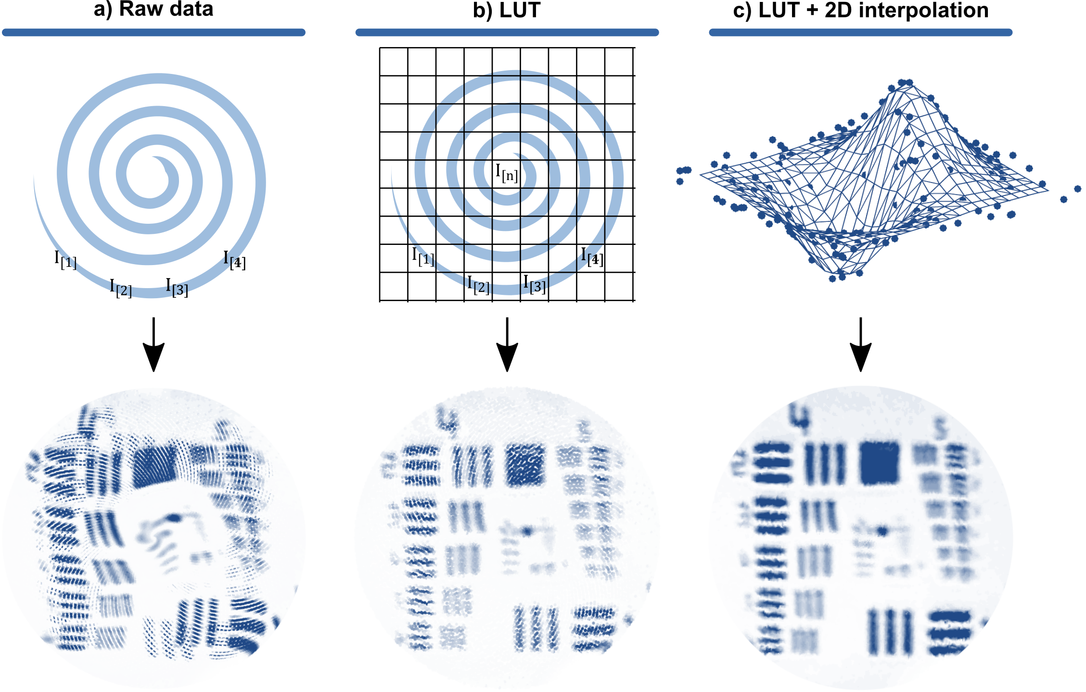
Experimental evaluation Distortion correction
Whirl patterns
Distortion Correction
Notes:
Distortion:
Non ideal beam: 2 axes of symmetry: eigendirection
Cross coupling of energy between them
Whirling
Solution:
WP far from resonance but enough gain
Look up table measured with PSD

Slide 20
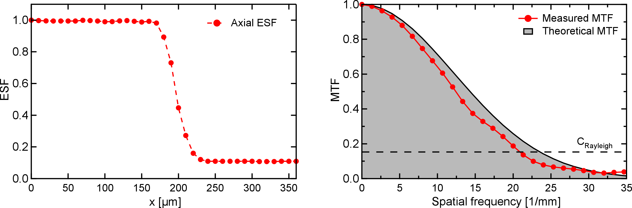
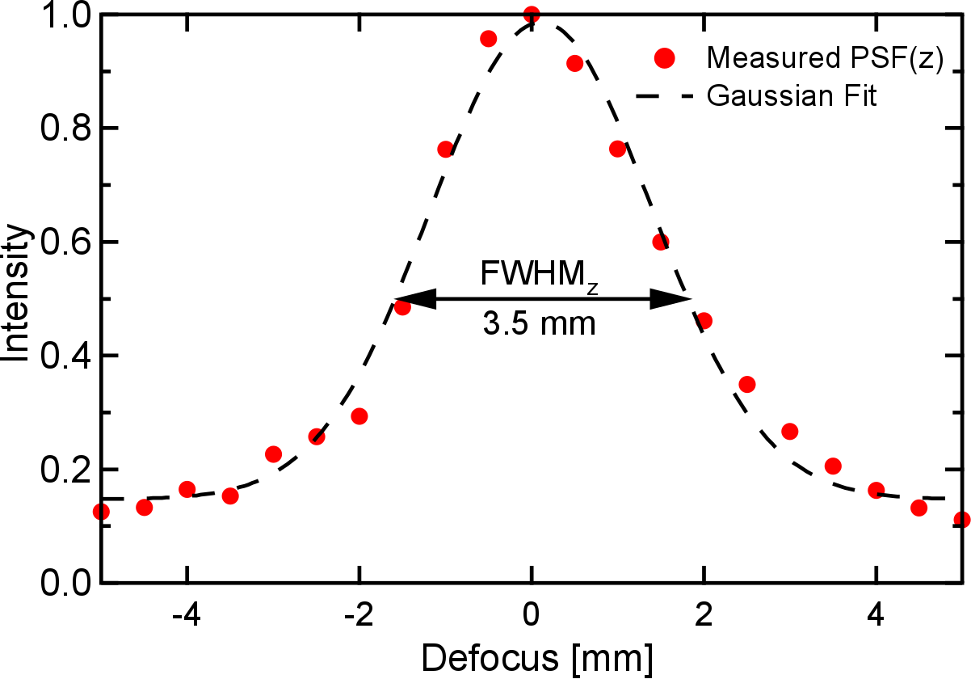
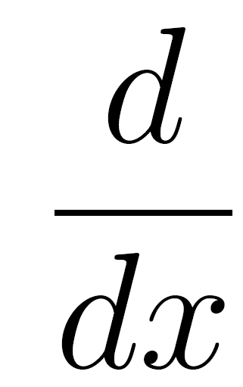

Experimental evaluation Resolution and field of view
Lateral resolution: 48 µm
Depth of Field: 3.5 mm
Edge Spread Function
,
MTF
Translated mirror
Notes:
Evaluate resolution:
Lateral resolution:
Edge (derivative) PSF (fourier) MTF

Slide 21

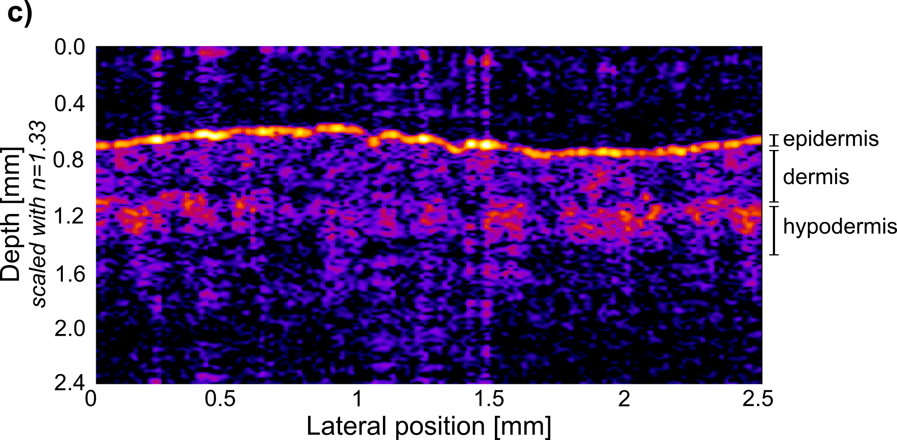
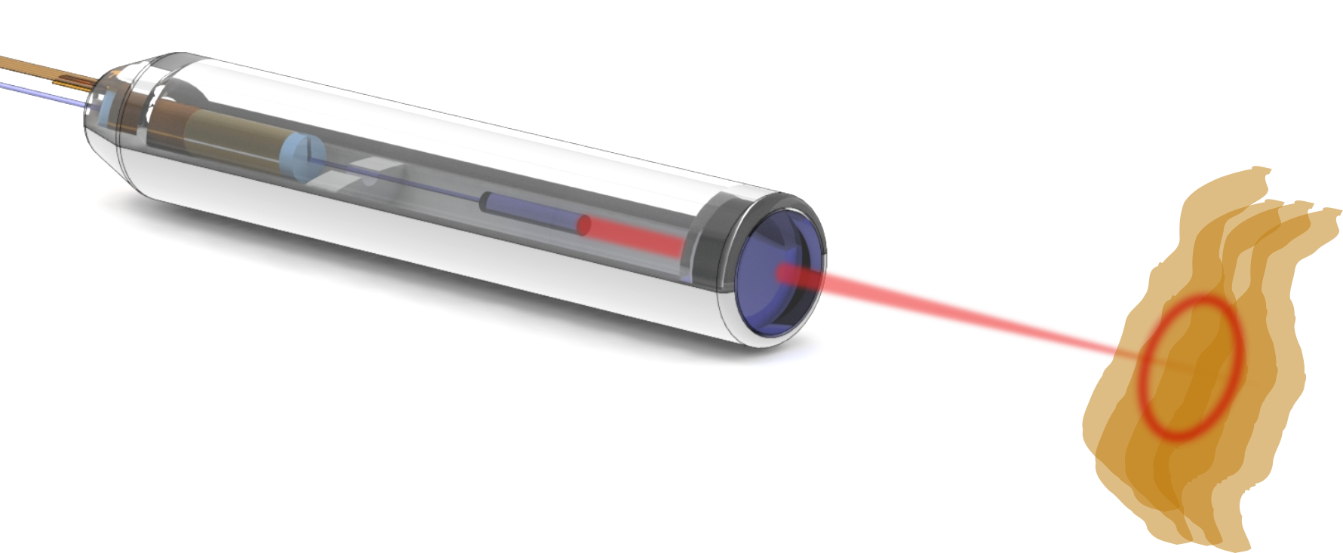
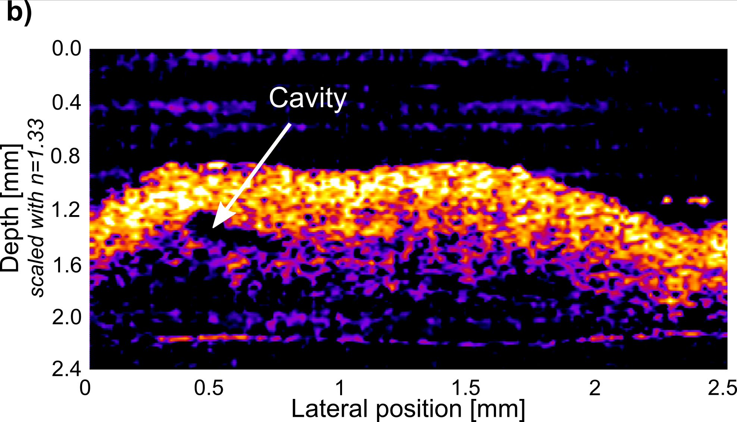
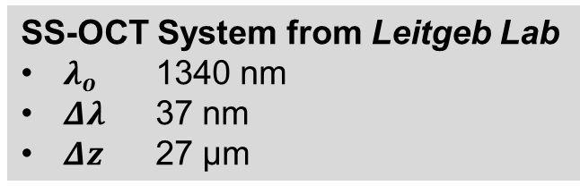
Experimental evaluation OCT cylindrical cross section imaging
Human fingertip
Human colon polyp
SS-OCT System from Leitgeb Lab
$λ_{o}$ 1340 nm
$Δλ$ 37 nm
$Δz$ 27 µm
1.4 mm
Notes:
Collaboration Leitgeb Lab
Acquired cylindrical cross sections
Fingertip: Surface topology + layers
Polyp: structures, glass
Low SNR: OCT setup not optimized for this scanning speed
Future: Assemble cylinders to 3D

Slide 22


Conclusion and Outlook
OCT scanning engine
Amongst most compact in literature
Accurate optical analysis
Guideline for future fiber scanners
Reduction of imaging distortions
OCT imaging
Internal structures
High penetration depth
Outlook:
Integration in double modality scanner
Combination of other scanning + full-field modalities
Notes:
Acknowledge Bilal Khatri (Hannemann group) and Woias group for the help in the 3D printing

Slide 23

Compact OCT scanner for a bimodal endoscopic probe
Sergio Vilches
Notes:
[Keep whole laser beam]

Slide 24



Piezoelectric tube actuator

Slide 25


Implementation Electrical contacts

Slide 26

Confocal resolution

Slide 27

Non-telecentric scanning

Slide 28

ZEMAX raytracing of bimodal probe

Slide 29


Sources of optical backreflections inside the probe

Slide 30

Fiber-GRIN Bonding

Slide 31



Spiral scanning Sampling

Slide 32

Implementation Performance

Slide 33

Effect of cantilever length in GRIN angle

